Slide 1
Perceptron training rule (delta rule)
w_{i} ← w_{i} + Δw_{i}
where Δw_{i} = η (t – o) x_{i}
Where:
t = c(x) is target value
o is perceptron output
η is small constant (e.g., 0.1) called learning rate
Can prove it will converge
If training data is linearly separable

Slide 2
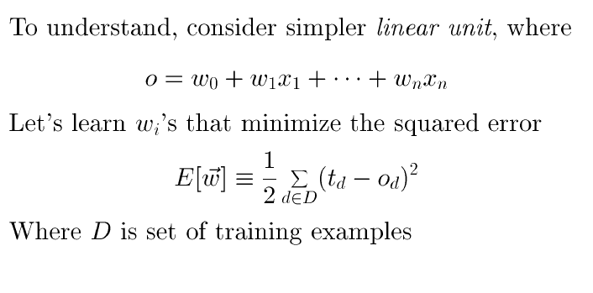
Gradient descent

Slide 3
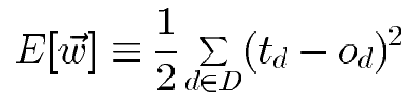
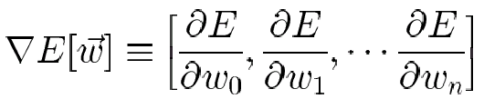
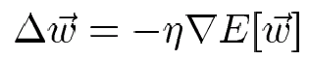
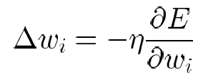
Derivation of gradient descent
Gradient descent
- Error (for all training examples.):
- the gradient of E ( partial differentiating ) :
- direction : steepest increase in E.
- Thus, training rule is as follows.
(The negative sign : the direction that decreases E)

Slide 4
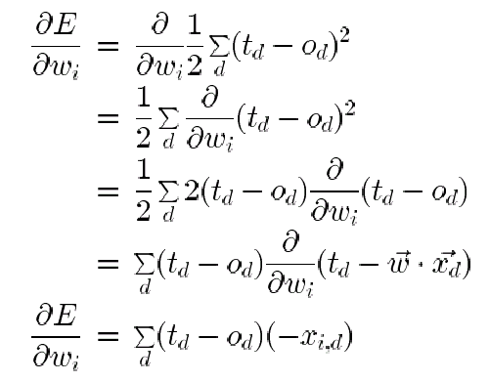
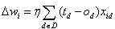
Derivation of gradient descent
where x_{id} denotes the single input components x_{i} for training example d
- The weight update rule for gradient descent
∴

Slide 5
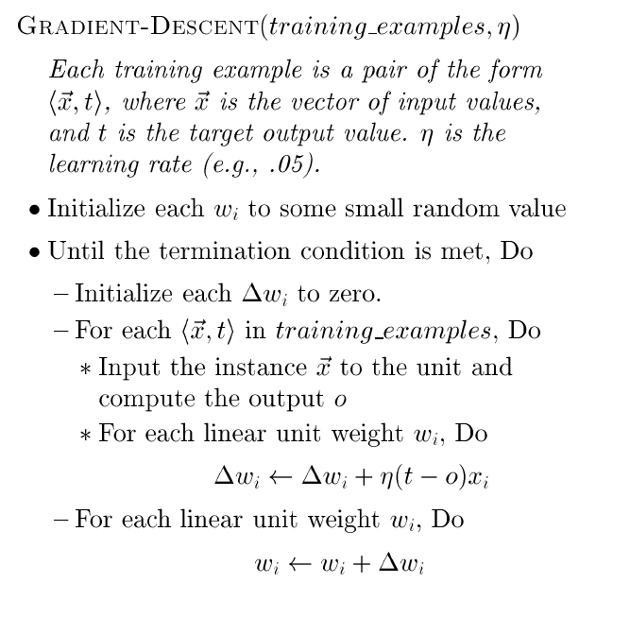
Gradient descent and delta rule
Because the error surface contains only a single global minimum, this algorithm will converge to a weight vector with minimum error, given a sufficiently small η is used

Slide 6
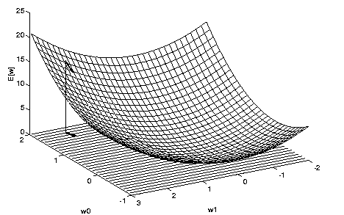
Hypothesis Space
- Error of different hypotheses
- For a linear unit with two weights, the hypothesis space H is the w_{o},w₁ plane.
- This error surface must be parabolic with a single global minimum (we desire a hypothesis with minimum error).

Slide 7
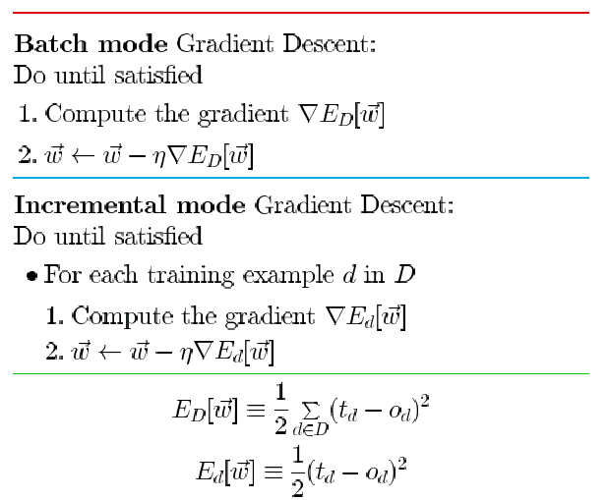
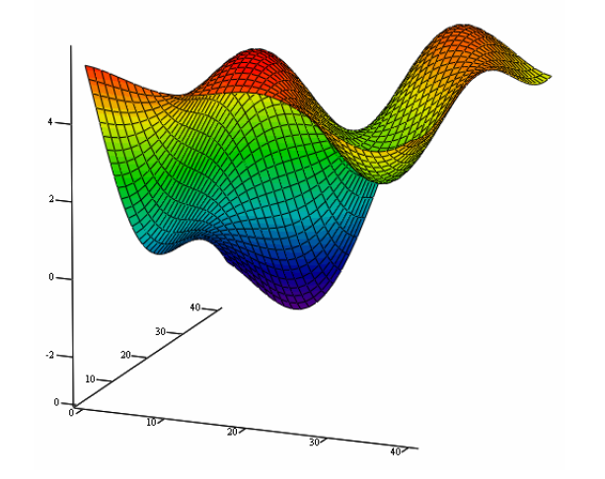
Stochastic approximation to gradient descent
- Stochastic gradient descent (i.e. incremental mode) can sometimes avoid falling into local minima because it uses the various gradient of E rather than overall gradient of E.

Slide 8
Summary
Perceptron training rule guaranteed to succeed if
training examples are linearly separable
Sufficiently small learning rate η
Linear unit training rule using gradient descent
Converge asymptotically to min. error hypothesis (Guaranteed to converge to hypothesis with minimum squared error )

Slide 9
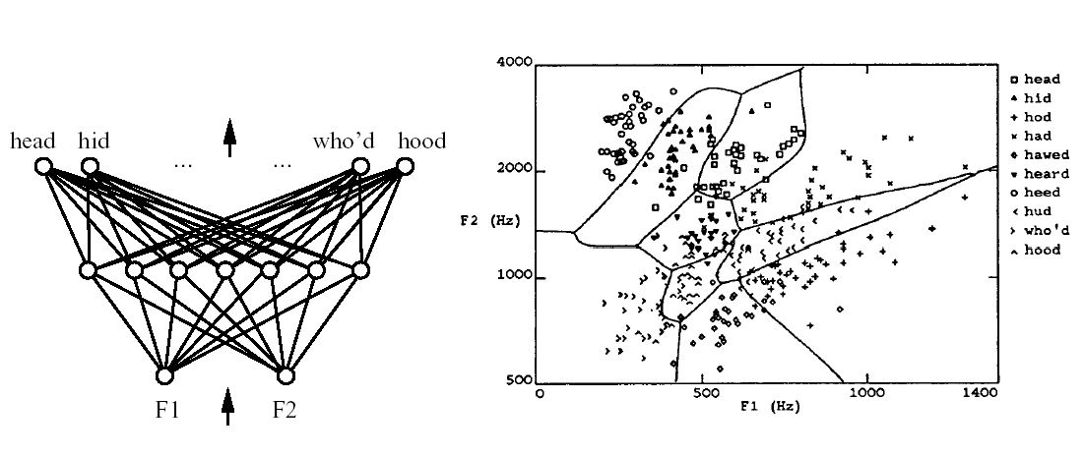
Multilayer networks and the backpropagation algorithm
Multilayer networks and the backpropagation algorithm
Speech recognition example of multilayer networks learned by the backpropagation algorithm
Highly nonlinear decision surfaces

Slide 10
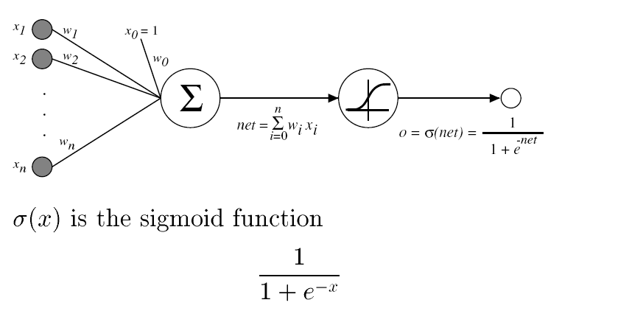
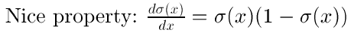
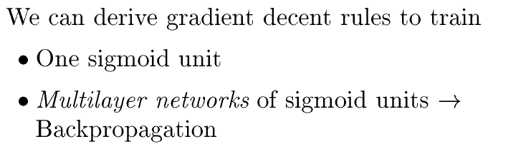
Sigmoid Threshold Unit

Slide 11
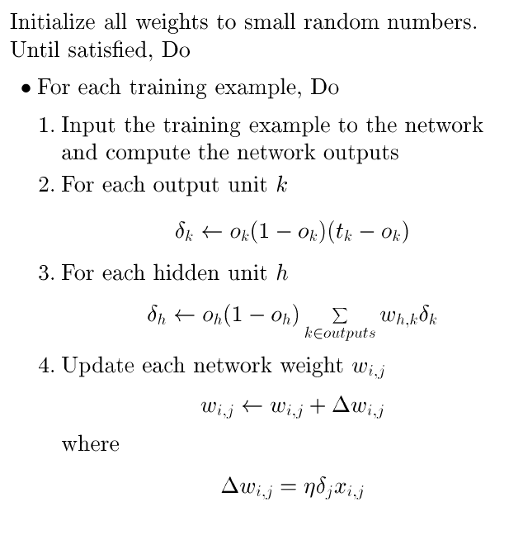
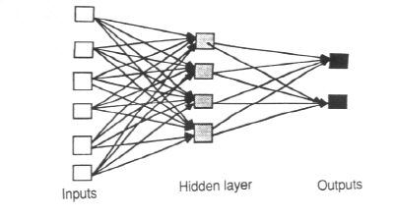
The Backpropagation algorithm

Slide 12
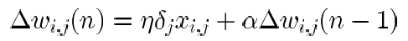
Adding Momentum
Often include weight momentum α
- n^{th} iteration update depend on (n-1)^{th} iteration
- α : constant between 0 and 1 (momentum)
Roles of momentum term
The effect of keeping the ball rolling through small local minima in the error surface
The effect of gradually increasing the step size of the search in regions (greatly improves the speed of learning)

Slide 13
Convergence and Local Minima
Gradient descent to some local minimum
Perhaps not global minimum...
Add momentum
Stochastic gradient descent

Slide 14
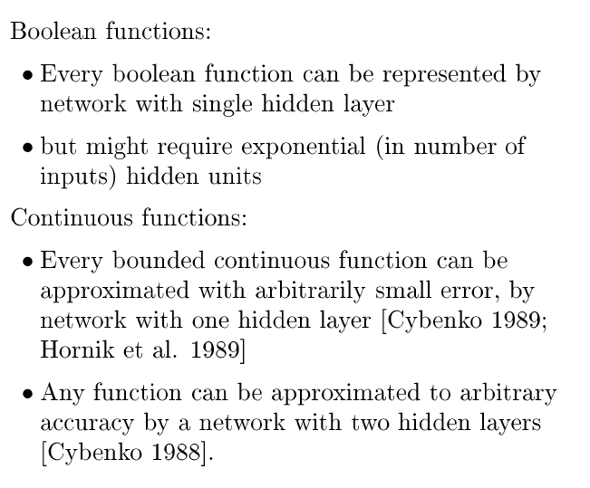
Expressive Capabilities of ANNs

Slide 15
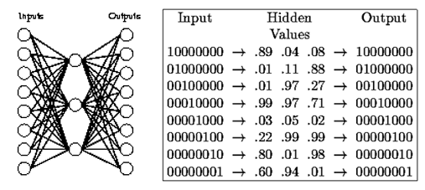
Hidden layer representations
Hidden layer representations
- This 8x3x8 network was trained to learn the identity function.
- 8 training examples are used.
- After 5000 training iterations, the three hidden unit values encode the eight distinct inputs using the encoding shown on the right.

Slide 16
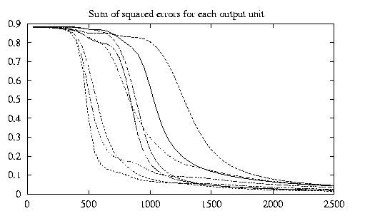
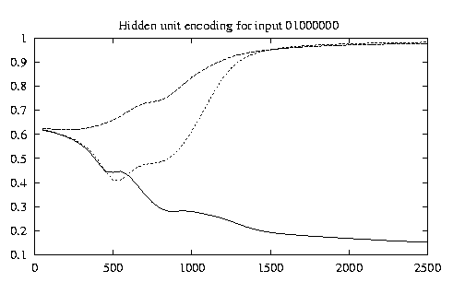
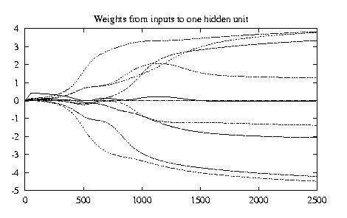
Learning the 8x3x8 network
- Most of the interesting weight changes occurred during the first 2500 iterations.

Slide 17
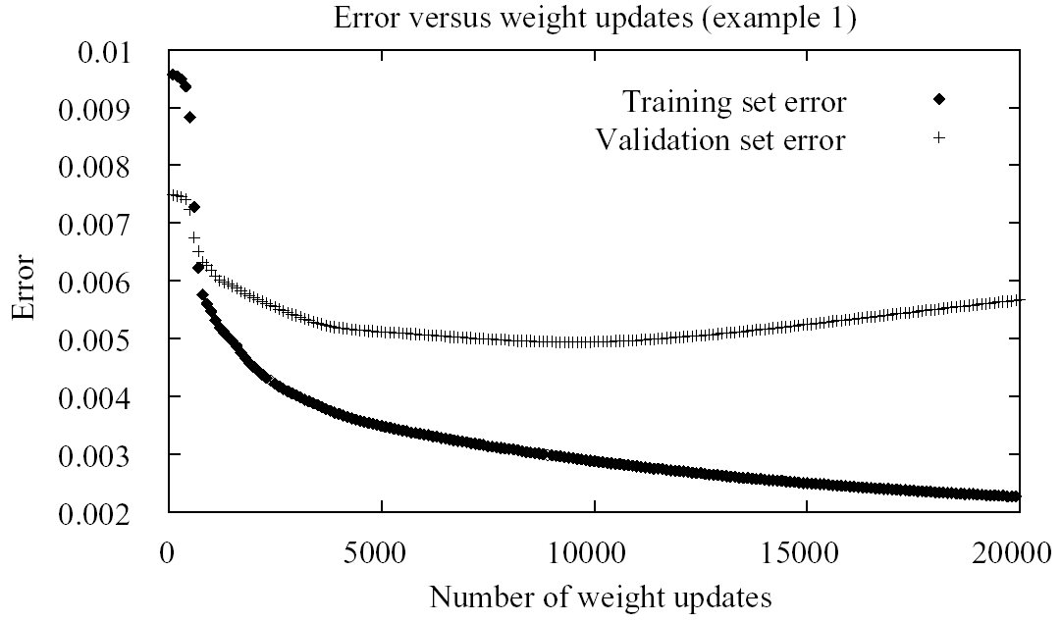
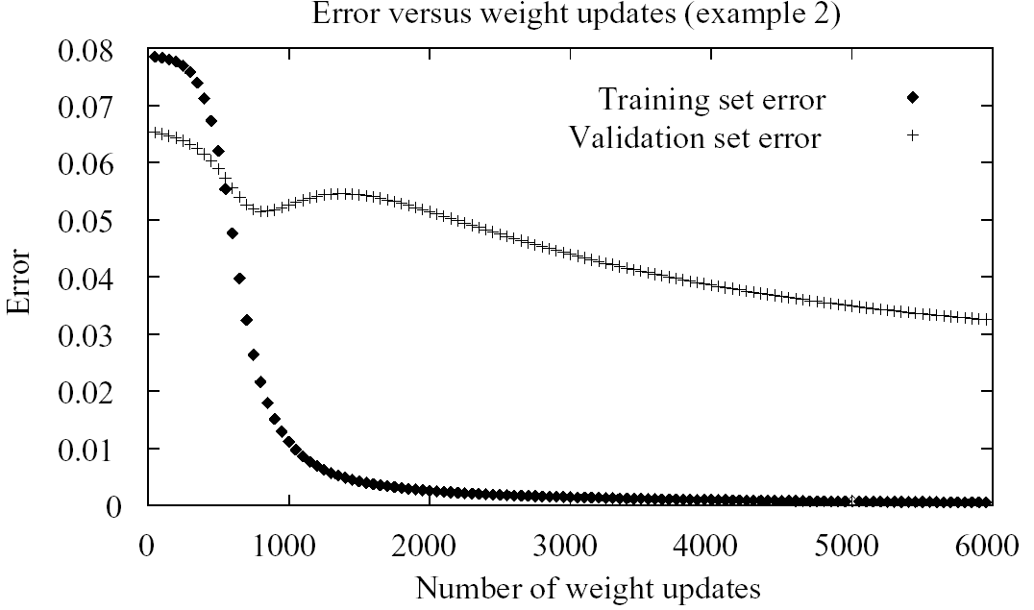
Generalization, Overfitting, and Stopping Criterion
Termination condition
Until the error E falls below some predetermined threshold
Techniques to address the overfitting problem
Weight decay : Decrease each weight by some small factor during each iteration.
Cross-validation (k-fold cross-validation)

Slide 18
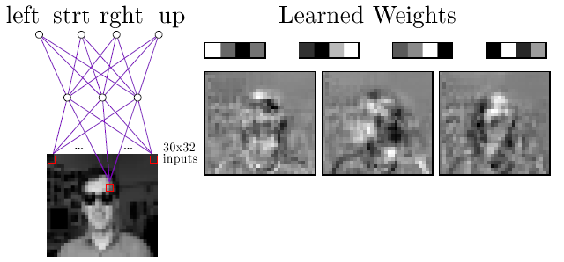
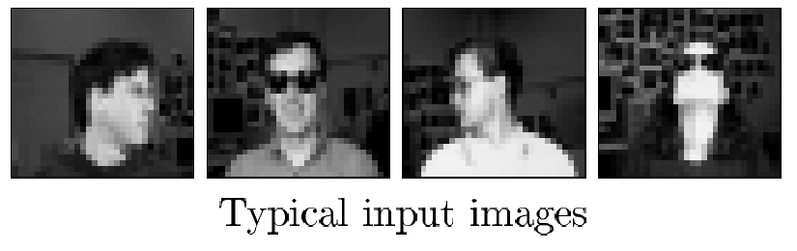
Neural Nets for Face Recognition
Training images : 20 different persons with 32 images per person.
After 260 training images, the network achieves an accuracy of 90% over test set.
Algorithm parameters : η=0.3, α=0.3

Slide 19
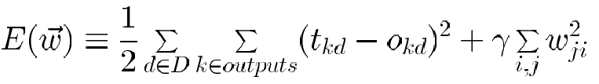
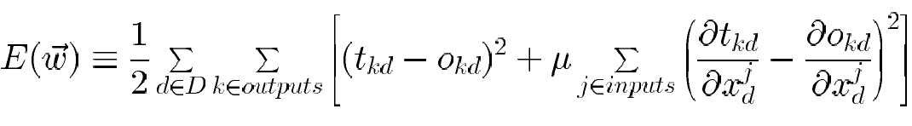
Alternative Error Functions
Penalize large weights: (weight decay) : Reducing the risk of overfitting
Train on target slopes as well as values:
Minimizing the cross entropy : Learning a probabilistic output function (chapter 6)

Slide 20
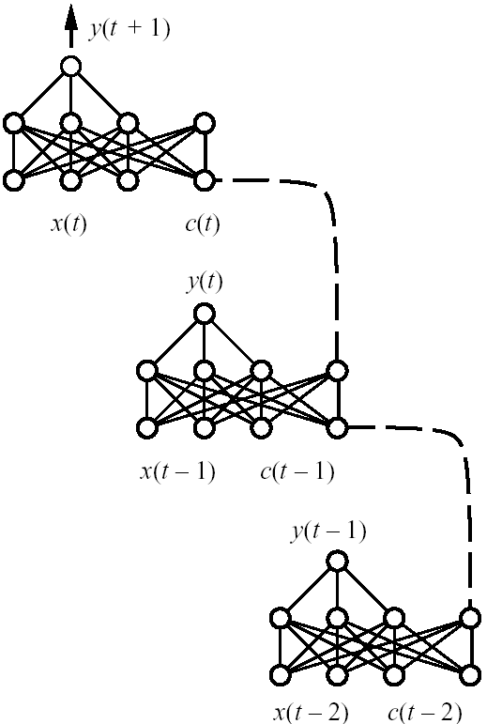
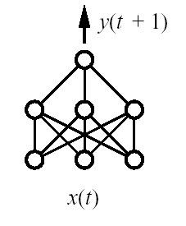
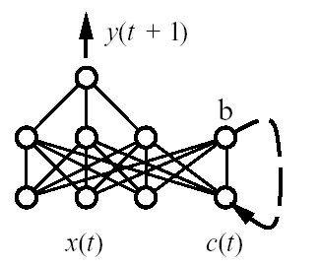
Recurrent Networks
(a)
(b)
(c)
Feedforward network
Recurrent network
Recurrent network unfolded
in time

Slide 21
Dynamically Modifying Network Structure
To improve generalization accuracy and training efficiency
Cascade-Correlation algorithm (Fahlman and Lebiere 1990)
Start with the simplest possible network (no hidden units) and add complexity
Lecun et al. 1990
Start with the complex network and prune it as we find that certain connectives are inessential.

Slide 22
Unsupervised Learning
We can include additional structure in the network so that the net is forced to make a decision as to which one unit will respond.
The mechanism by which it is achieved is called competition.
It can be used in unsupervised learning.
A common use for unsupervised learning is clustering based neural networks.

Slide 23
Unsupervised Learning
In a clustering net, there are as many units as the input vector has components.
Every output unit represents a cluster and the number of output units limit the number of clusters.
During the training, the network finds the best matching output unit to the input vector.
The weight vector of the winner is then updated according to learning algorithm.

Slide 24
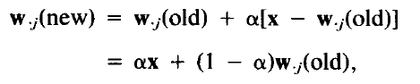
Kohonen Learning
A variety of nets use Kohonen Learning
New weight vector is the linear combination of old weight vector and the current input vector.
The weight update for cluster unit (output unit) j can be calculated as:
the learning rate alpha decreases as the learning process proceeds.

Slide 25
Kohonen SOM (Self Organizing Maps)
Since it is unsupervised environment, so the name is Self Organizing Maps.
Self Organizing NNs are also called Topology Preserving Maps which leads to the idea of neighborhood of the clustering unit.
During the self-organizing process, the weight vectors of winning unit and its neighbors are updated.

Slide 26
Kohonen SOM (Self Organizing Maps)
Normally, Euclidean distance measure is used to find the cluster unit whose weight vector matches most closely to the input vector.
For a linear array of cluster units, the neighborhood of radius R around cluster unit J consists of all units j such that:

Slide 27
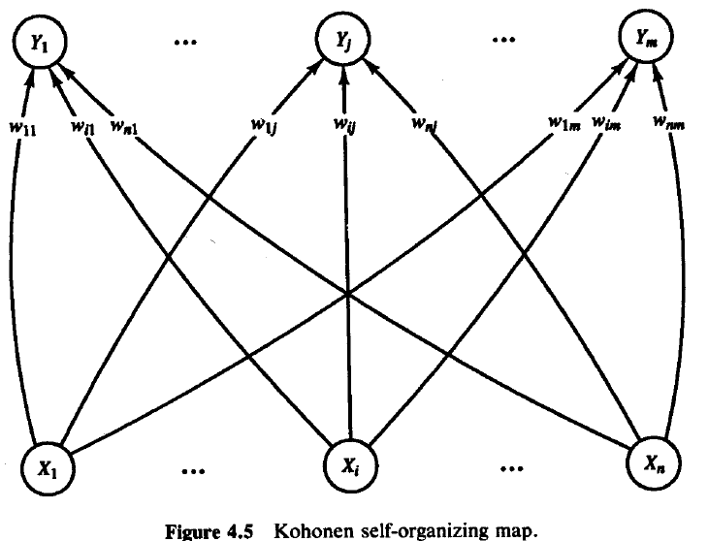
Kohonen SOM (Self Organizing Maps)
Architecture of SOM

Slide 28
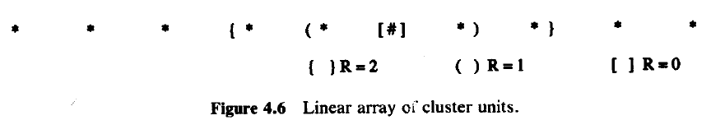
Kohonen SOM (Self Organizing Maps)
Structure of Neighborhoods

Slide 29
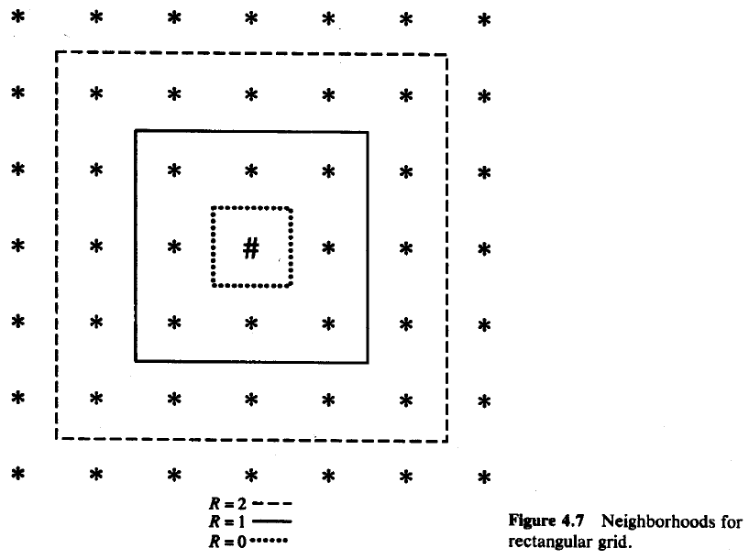
Kohonen SOM (Self Organizing Maps)
Structure of Neighborhoods

Slide 30
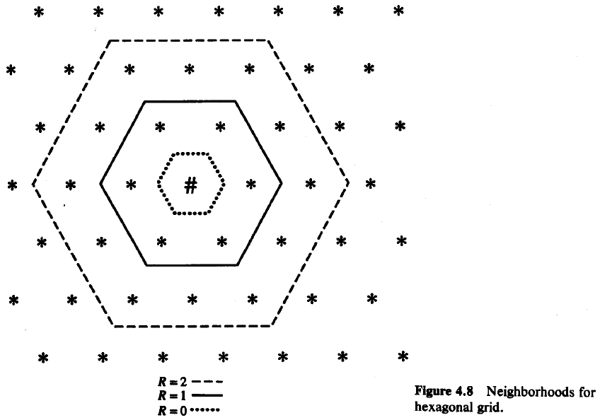
Kohonen SOM (Self Organizing Maps)
Structure of Neighborhoods

Slide 31
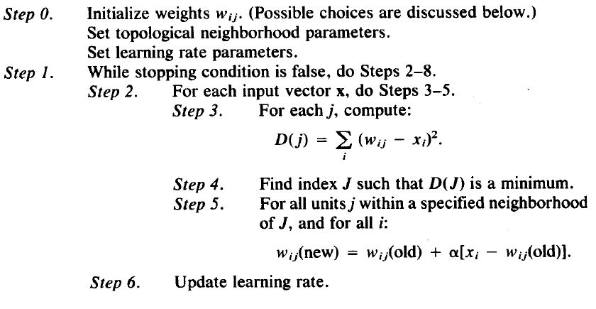
Kohonen SOM (Self Organizing Maps)
Neighborhoods do not wrap around from one side of the grid to other side which means missing units are simply ignored.
Algorithm:

Slide 32
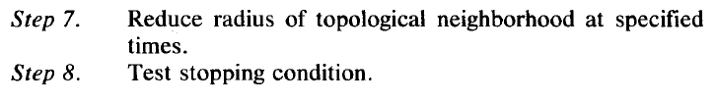
Kohonen SOM (Self Organizing Maps)
Algorithm:
Radius and learning rates may be decreased after each epoch.
Learning rate decrease may be either linear or geometric.

Slide 33
KOHONEN SELF ORGANIZING MAPS
Architecture
neuron i
Kohonen layer
w_{i}
Winning neuron
Input vector X
X=[x₁,x₂,…x_{n}] ∈ R^{n}
w_{i}=[w_{i1},w_{i2},…,w_{in}] ∈ R^{n}

Slide 34
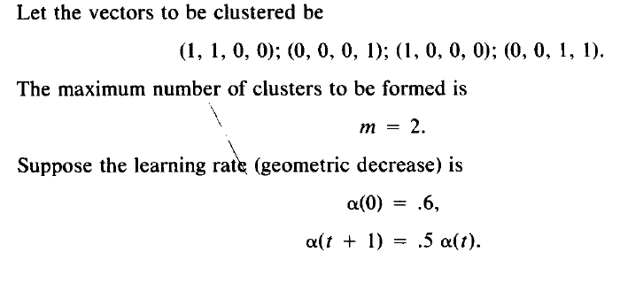
Kohonen SOM (Self Organizing Maps)
Example

Slide 35
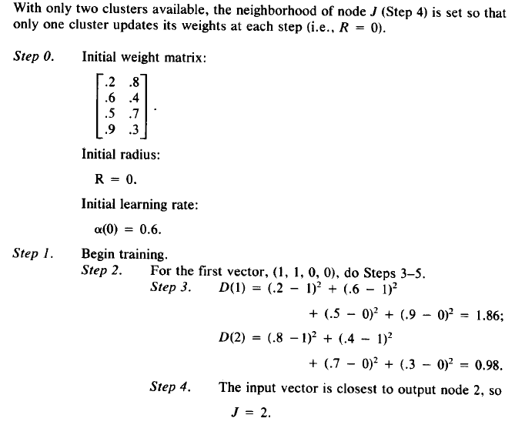
Kohonen SOM (Self Organizing Maps)

Slide 36
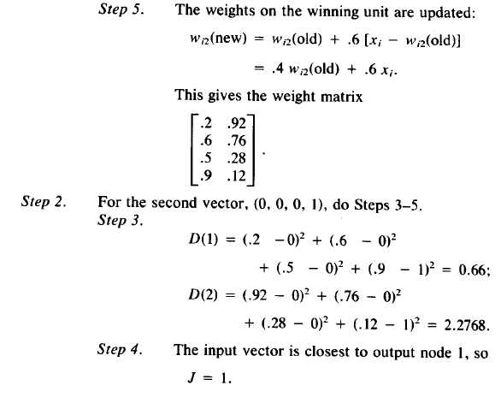
Kohonen SOM (Self Organizing Maps)

Slide 37
Convolutional Neural Network

Slide 38

History
In 1995, Yann LeCun and Yoshua Bengio introduced the concept of convolutional neural networks.

Slide 39
“Deep Learning doesn’t do different things, it does things differently”

Slide 40
Performance vs Sample Size
Deep Learning algorithms
Performance
Traditional ML algorithms
Size of Data

Slide 41
Outline
Supervised Learning
Convolutional Neural Network
Sequence Modelling: RNN and its extensions
Unsupervised Learning
Autoencoder
Stacked Denoising Autoencoder
Unsupervised Learning (+Supervised)
Generative Adversarial Networks
Reinforcement Learning
Deep Reinforcement Learning

Slide 42

Outline
GAN
Produce Poetry like Shakespeare
Output
Generated Shakespeare Poetry
Generator Network
Input
Discriminator Network
Fake
Real
Shakespeare Poetry
Real

Slide 43
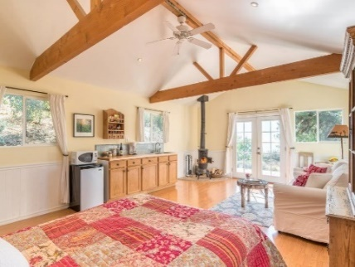
Supervised Learning
Traditional pattern recognition models work with hand crafted features and relatively simple trainable classifiers.
Limitations
Limitations
Very tedious and costly to develop hand crafted features.
The hand-crafted features are usually highly dependents on one application.
Trainable Classifier
(e.g. SVM, Random Forrest)
Extract Hand Crafted Features
Output
(e.g. Outdoor Yes or No)

Slide 44


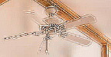
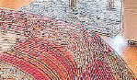
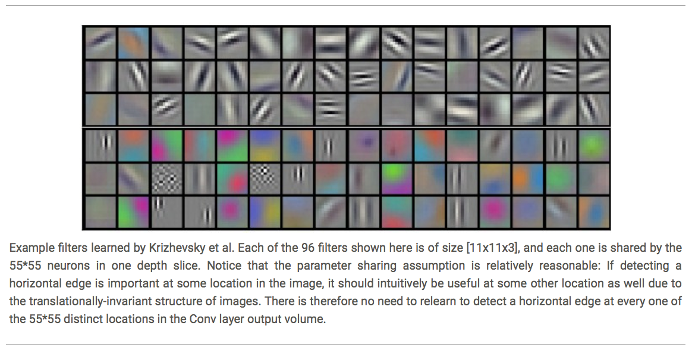
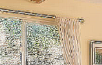
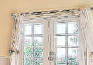
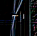

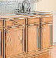











Deep Learning
Deep learning has an inbuilt automatic multi stage feature learning process that learns rich hierarchical representations (i.e. features).
Low Level Features
Mid Level Features
High Level Features
Trainable Classifier
Output
(e.g. outdoor, indoor)

Slide 45
Deep Learning
Low Level Features
Mid Level Features
High Level Features
Trainable Classifier
Input
Output
Image
Pixel Edge Texture Motif Part Object
Text
Character Word Word-group Clause Sentence Story
Each module in Deep Learning transforms its input representation into a higher-level one, in a way similar to human cortex.

Slide 46
Let us see how it all works!

Slide 47
A Simple Neural Network
An Artificial Neural Network is an information processing paradigm that is inspired by the biological nervous systems, such as the human brain’s information processing mechanism.
x1
a1⁽¹⁾
x2
a2⁽¹⁾
a1⁽²⁾
Y
x3
a3⁽¹⁾
x4
a4⁽¹⁾
Input
Hidden Layers
Output

Slide 48


A Simple Neural Network
Softmax
w1
$$\frac{1}{1+e^{−w{∗a1}^{(2)}}}$$
x1
x1
a1⁽¹⁾
a1⁽¹⁾
w2
x2
x2
a2⁽¹⁾
w3
Y
a1⁽²⁾
x3
x3
a3⁽¹⁾
w4
x4
x4
a4⁽¹⁾
$${a1}^{(1)}=f\left(w1∗x1+w2∗x2+w3∗x3+w4∗x4\right)$$
f( ) is activation function: Relu or sigmoid
$$Relu:max⁡(0,x)$$
$${a1}^{(1)}=max\left(0, w1∗x1+w2∗x2+w3∗x3+w4∗x4\right)$$

Slide 49
Number of Parameters
Softmax
x1
a1⁽¹⁾
x2
a2⁽¹⁾
a1⁽²⁾
Y
x3
a3⁽¹⁾
x4
a4⁽¹⁾
Input
Hidden Layers
Output
4*4 + 4 +1

Slide 50
If the input is an Image?
x1
a1⁽¹⁾
x2
a2⁽¹⁾
a1⁽²⁾
Y
x3
a3⁽¹⁾
400 X 400 X 3
a480000⁽¹⁾
x480000
Input
Hidden Layers
Output
Number of Parameters
480000*480000 + 480000 +1 = approximately 230 Billion !!!
480000*1000 + 1000 +1 = approximately 480 million !!!

Slide 51
Let us see how convolutional layers help.

Slide 52


Convolutional Layers
0 1 0
1 -4 1
0 1 0
Filter
Input Image
Convoluted Image
Inspired by the neurophysiological experiments conducted by Hubel and Wiesel 1962.

Slide 53
Convolutional Layers
What is Convolution?
$$h1=f\left(a∗w1+b∗w2+e∗w3+f∗w4\right)$$
a | b | c | d
e | f | g | h
i | j | k | l
m | n | o | p
w1 | w2
w3 | w4
h1 | h2
Input Image
Filter
Convolved Image
(Feature Map)
$$h2=f\left(b∗w1+c∗w2+f∗w3+g∗w4\right)$$
Number of Parameters for one feature map = 4
Number of Parameters for 100 feature map = 4*100

Slide 54
Lower Level to More Complex Features
w1 | w2
w3 | w4
w5 | w6
w7 | w8
Filter 1
Filter 2
Input Image
Layer 1 Feature Map
Layer 2 Feature Map
In Convolutional neural networks, hidden units are only connected to local receptive field.

Slide 55
Pooling
Max pooling: reports the maximum output within a rectangular neighborhood.
Average pooling: reports the average output of a rectangular neighborhood.
MaxPool with 2X2 filter with stride of 2
1 | 3 | 5 | 3
4 | 2 | 3 | 1
3 | 1 | 1 | 3
0 | 1 | 0 | 4
4 | 5
3 | 4
Input Matrix
Output Matrix

Slide 56

Convolutional Neural Network
Maxpool Output Vector
Feature Extraction Architecture
Living Room
Bed Room
64
64
128
128
256
256
256
512
512
512
512
512
512
Kitchen
Bathroom
Outdoor
Max Pool
Filter
Fully Connected Layers

Slide 57
Convolutional Neural Networks
Output: Binary, Multinomial, Continuous, Count
Input: fixed size, can use padding to make all images same size.
Architecture: Choice is ad hoc
requires experimentation.
Optimization: Backward propagation
hyper parameters for very deep model can be estimated properly only if you have billions of images.
Use an architecture and trained hyper parameters from other papers (Imagenet or Microsoft/Google APIs etc)
Computing Power: Buy a GPU!!

Slide 58

Automatic Colorization of Black and White Images

Slide 59






Optimizing Images
Post Processing Feature Optimization (Color Curves and Details)
Post Processing Feature Optimization (Illumination)
Post Processing Feature Optimization (Color Tone: Warmness)

Slide 60


Slide 61
Convolution
1D (continuous, discrete) :
Input
∞
Kernel
f * g (x) =
∫ f (α )g(x −α )dα
α =−∞
N −1
Output is
=
∑
f (α )g(x −α )
sometimes called
α =0
Feature map
2D (continuous, discrete) :
∞ ∞
f * g (x, y) =
∫
∫ f (α , β )g(x −α , y − β )dαdβ
α =−∞ β =−∞
N −1 N −1
= ∑ ∑ f (α , β )g(x −α , y − β )
α =0 β =0

Slide 62
Convolution Properties
Commutative:
f*g = g*f
Associative:
(f*g)*h = f*(g*h)
Homogeneous:
f*(λg)= λ f*g
Additive (Distributive):
f*(g+h)= f*g+f*h
Shift-Invariant
f*g(x-x0,y-yo)= (f*g) (x-x0,y-yo)

Slide 63
ConvNet
ConvNet architectures for images:
fully-connected structure does not scale to large images
the explicit assumption that the inputs are images
allows us to encode certain properties into the architecture.
These then make the forward function more efficient to implement
Vastly reduce the amount of parameters in the network.
3D volumes: neurons arranged in 3 dimensions: width, height, depth.

Slide 64


Convnets
Layers used to build ConvNets:
a stacked sequence of layers. 3 main types
Convolutional Layer, Pooling Layer, and Fully- Connected Layer
every layer of a ConvNet transforms one volume of activations to another through a differentiable function.

Slide 65
The replicated feature approach
Use many different copies of the
same feature detector with different positions.
Could also replicate across scale and orientation (tricky and expensive)
Replication greatly reduces the number of free parameters to be learned.
Use several different feature types, each with its own map of replicated detectors.
– Allows each patch of image to be represented in several ways.
The red connections all have the same weight.

Slide 66
Backpropagation with weight constraints
To constrain : w₁ = w₂ we need : Δw₁ = Δw₂
It’s easy to modify the backpropagation algorithm to incorporate linear constraints between the weights.
We compute the gradients as usual, and then modify the gradients so that they satisfy the constraints.
– So if the weights started off satisfying the constraints, they will continue to satisfy them.
∂E ∂E
compute :
and
∂w₁ ∂w₂
∂E ₊ ∂E
use
for w₁ and w₂
∂w₁ ∂w₂

Slide 67
What does replicating the feature detectors achieve?
Equivariant activities: Replicated features do not make the neural activities invariant to translation. The activities are equivariant.
representation by active neurons
translated representation
translated image
image
Invariant knowledge: If a feature is useful in some locations during training, detectors for that feature will be available in all locations during testing.

Slide 68
Pooling the outputs of replicated feature detectors
Get a small amount of translational invariance at each level by averaging four neighboring replicated detectors to give a single output to the next level.
This reduces the number of inputs to the next layer of feature extraction, thus allowing us to have many more different feature maps.
Taking the maximum of the four works slightly better.
Problem: After several levels of pooling, we have lost information about the precise positions of things.
This makes it impossible to use the precise spatial relationships between high-level parts for recognition.

Slide 69
Example Architecture for CIFAR-10
[INPUT - CONV - RELU - POOL - FC]
INPUT [32x32x3] : the raw pixel values of the image
CONV will compute the output of neurons that are connected to local regions in the input. With 12 filters, the output volume is [32x32x12]
RELU : apply an elementwise activation function, such as the max(0,x)
POOL will perform a downsampling operation along the spatial dimensions (width, height), resulting in volume such as [16x16x12].
FC layer will compute the class scores, resulting in volume of size [1x1x10], where each of the 10 numbers correspond to a class score, such as among the 10 categories of CIFAR-10

Slide 70
Convolution Layer
The Conv layer is the core building block of a CNN
The parameters consist of a set of learnable filters.
Every filter is small spatially (width and height), but extends through the full depth of the input volume, eg, 5x5x3
During the forward pass, we slide (convolve) each filter across the width and height of the input volume and compute dot products between the entries of the filter and the input at any position.
produce a 2-dimensional activation map that gives the responses of that filter at every spatial position.
Intuitively, the network will learn filters that activate when they see some type of visual feature
A set of filters in each CONV layer
each of them will produce a separate 2-dimensional activation map
We will stack these activation maps along the depth dimension and produce the output volume.

Slide 71
Convolutional Neural Network 2

Slide 72


Convolution

Slide 73
Convolutions: More detail
32x32x3 image
32
height
32
depth
width
3

Slide 74
Convolutions: More detail
32x32x3 image
5x5x3 filter
32
Convolve the filter with the image
i.e. “slide over the image spatially,
computing dot products”
32
3

Slide 75


Convolutions: More detail
Convolution Layer
32x32x3 image
5x5x3 filter
32
1 number:
the result of taking a dot product between the
filter and a small 5x5x3 chunk of the image
(i.e. 5*5*3 = 75-dimensional dot product + bias)
32
3

Slide 76
Convolutions: More detail
Convolution Layer
32x32x3 image 5x5x3 filter
32
activation map
28
convolve (slide) over all spatial locations
32
28
3
1

Slide 77
Convolutions: More detail
Convolution Layer
consider a second, green filter
32x32x3 image
5x5x3 filter
activation maps
32
28
convolve (slide) over all spatial locations
32
28
3
1

Slide 78
Convolutions: More detail
For example, if we had 6 5x5 filters, we’ll get 6 separate activation maps:
activation maps
32
28
Convolution Layer
32
28
3
6
We stack these up to get a “new image” of size 28x28x6!

Slide 79
Convolutions: More detail
Preview: ConvNet is a sequence of Convolution Layers, interspersed with
activation functions
32
28
CONV, ReLU
e.g. 6 5x5x3 filters
32
28
3
6

Slide 80
Convolutions: More detail
Preview: ConvNet is a sequence of Convolutional Layers, interspersed with activation
functions
32
28
24
….
CONV, ReLU
e.g. 6 5x5x3 filters
CONV, ReLU
e.g. 10 5x5x6 filters
CONV, ReLU
32
28
24
3
6
10

Slide 81

Convolutions: More detail
Preview
[From recent Yann LeCun slides]

Slide 82


Convolutions: More detail
one filter => one activation map
example 5x5 filters
(32 total)
We call the layer convolutional because it is related to convolution of two signals:
elementwise multiplication and sum of a filter and the signal (image)

Slide 83
Convolutions: More detail
A closer look at spatial dimensions:
activation map
32x32x3 image 5x5x3 filter
32
28
convolve (slide) over all
spatial locations
32
28
3
1

Slide 84
Convolutions: More detail
A closer look at spatial dimensions:
7
7x7 input (spatially) assume 3x3 filter
•
7

Slide 85
Convolutions: More detail
A closer look at spatial dimensions:
7
7x7 input (spatially) assume 3x3 filter
•
7

Slide 86
Convolutions: More detail
A closer look at spatial dimensions:
•
7
7x7 input (spatially) assume 3x3 filter
•
7

Slide 87
Convolutions: More detail
A closer look at spatial dimensions:
•
7
7x7 input (spatially) assume 3x3 filter
•
7

Slide 88
Convolutions: More detail
A closer look at spatial dimensions:
7
 |  |  | •
7x7 input (spatially) assume 3x3 filter
=> 5x5 output
7

Slide 89
Convolutions: More detail
A closer look at spatial dimensions:
7
7x7 input (spatially) assume 3x3 filter applied with stride 2
7

Slide 90
Convolutions: More detail
A closer look at spatial dimensions:
7
7x7 input (spatially) assume 3x3 filter applied with stride 2
7

Slide 91
Convolutions: More detail
A closer look at spatial dimensions:
7
7x7 input (spatially) assume 3x3 filter applied with stride 2
=> 3x3 output!
7

Slide 92
Convolutions: More detail
A closer look at spatial dimensions:
7
7x7 input (spatially) assume 3x3 filter applied with stride 3?
7

Slide 93
Convolutions: More detail
A closer look at spatial dimensions:
7
7x7 input (spatially) assume 3x3 filter applied with stride 3?
7
doesn’t fit!
cannot apply 3x3 filter on 7x7 input with stride 3.

Slide 94
Convolutions: More detail
N
Output size:
(N - F) / stride + 1
 |  |  | F
 | F
e.g. N = 7, F = 3:
stride 1 => (7 - 3)/1 + 1 = 5
stride 2 => (7 - 3)/2 + 1 = 3
stride 3 => (7 - 3)/3 + 1 = 2.33 :\
N

Slide 95
Convolutions: More detail
In practice: Common to zero pad the border
0 | 0 | 0 | 0 | 0 | 0
0
0
0
0
e.g. input 7x7
3x3 filter, applied with stride 1
pad with 1 pixel border => what is the output?
(recall:)
(N - F) / stride + 1

Slide 96
Convolutions: More detail
In practice: Common to zero pad the border
0 | 0 | 0 | 0 | 0 | 0
0
0
0
0
e.g. input 7x7
3x3 filter, applied with stride 1
pad with 1 pixel border => what is the output?
7x7 output!

Slide 97
Convolutions: More detail
In practice: Common to zero pad the border
0 | 0 | 0 | 0 | 0 | 0
0
0
0
0
e.g. input 7x7
3x3 filter, applied with stride 1
pad with 1 pixel border => what is the output?
7x7 output!
in general, common to see CONV layers with stride 1, filters of size FxF, and zero-padding with (F-1)/2. (will preserve size spatially)
e.g. F = 3 => zero pad with 1 F = 5 => zero pad with 2 F = 7 => zero pad with 3
(N + 2*padding - F) / stride + 1

Slide 98
Convolutions: More detail
Examples time:
Input volume: 32x32x3
10 5x5 filters with stride 1, pad 2
Output volume size: ?

Slide 99
Convolutions: More detail
Examples time:
Input volume: 32x32x3
10 5x5 filters with stride 1, pad 2
Output volume size:
(32+2*2-5)/1+1 = 32 spatially, so
32x32x10

Slide 100
Convolutions: More detail
Examples time:
Input volume: 32x32x3
10 5x5 filters with stride 1, pad 2
Number of parameters in this layer?

Slide 101
Convolutions: More detail
Examples time:
Input volume: 32x32x3
10 5x5 filters with stride 1, pad 2
Number of parameters in this layer? each filter has 5*5*3 + 1 = 76 params
=> 76*10 = 760
(+1 for bias)

Slide 102

Convolutions: More detail

Slide 103
Spatial arrangement
Three hyperparameters control the size of the output volume
Depth: no of filters, each learning to look for something different in the input.
the stride with which we slide the filter.
pad the input volume with zeros around the border.

Slide 104
Spatial arrangement
We compute the spatial size of the output volume as a function of
the input volume size (W)
the receptive field size of the Conv Layer neurons (F)
the stride with which they are applied (S)
the amount of zero padding used (P) on the border.
The number of neurons that “fit” is given by (W−F+2P)/(S+1)
For a 7x7 input and a 3x3 filter with stride 1 and pad 0 we would get a 5x5 output.
With stride 2 we would get a 3x3 output.

Slide 105

one spatial dimension (x-axis), one neuron with a receptive field size of F = 3, the input size is W = 5, and zero padding of P = 1
Stride = 1, 2
The Krizhevsky et al. architecture that won the ImageNet 2012
images of size [227x227x3].
the first Convolutional Layer, used neurons with receptive field size F=11, stride S=4, no zero padding P=0
Since (227 - 11)/4 + 1 = 55, the Conv layer had a depth of K=96,
the Conv layer output volume had size [55x55x96].
Each of the 55*55*96 neurons in this volume was connected to a region of size [11x11x3] in the input volume.
Moreover, all 96 neurons in each depth column are connected to the same
[11x11x3] region of the input,

Slide 106
Parameter Sharing
Parameter sharing controls the number of parameters.
If there are 55*55*96 = 290,400 neurons in the first Conv Layer, and each has 11*11*3 = 363 weights and 1 bias. Together, this adds up to 290400 * 364 = 105,705,600 parameters on the first layer of the ConvNet alone.
Reduce by parameter sharing
now have only 96 unique set of weights (one for each depth slice), for a total of 96*11*11*3 = 34,848 unique weights, or 34,944 parameters (+96 biases)
During backpropagation, every neuron in the volume will compute the gradient for its weights, but these gradients will be added up across each depth slice and only update a single set of weights per slice.

Slide 107

Example filters learned by Krizhevsky.
96 filters each of size [11x11x3], each is shared by the 55*55 neurons in one depth slice.

Slide 108
Summary of Conv Layer
Accepts a volume of size W1×H1×D1
Requires four hyperparameters:
Number of filters K
their spatial extent F
the stride S
the amount of zero padding P
Produces a volume of size W2×H2×D2
– W2=(W1−F+2P)/S+1
– H2=(H1−F+2P)/S+1
D2=K
With parameter sharing, it introduces F⋅F⋅D1 weights per filter, for a total
of (F⋅F⋅D1)⋅K weights and K biases.
In the output volume, the d-th depth slice (of size W2×H2) is the result of performing a valid convolution of the d-th filter over the input volume with a stride of S, and then offset by d-th bias.

Slide 109



Spatial Pooling
Sum or max over non-overlapping / overlapping regions
Role of pooling:
Invariance to small transformations
Larger receptive fields (neurons see more of input)
Max
Sum

Slide 110


3. Spatial Pooling
Sum or max over non-overlapping / overlapping regions
Role of pooling:
Invariance to small transformations
Larger receptive fields (neurons see more of input)

Slide 111
Pooling Layer
Insertion of pooling layer:
– reduce the spatial size of the representation
reduce the amount of parameters and computation in the network, and hence also control overfitting.
The Pooling Layer operates independently on every depth slice of the input and resizes it spatially, using the MAX operation.
The most common form is a pooling layer with filters of size 2x2 applied with a stride of 2 -- downsamples every depth slice in the input by 2 along both width and height,
MAX operation would in take a max over 4 numbers (little 2x2 region in some depth slice).
The depth dimension remains unchanged.

Slide 112
General pooling layer
Accepts a volume of size W1×H1×D1
Requires two hyperparameters:
their spatial extent F
the stride S
Produces a volume of size W2×H2×D2 where:
– W2=(W1−F)/S+1
– H2=(H1−F)/S+1
– D2=D1
Introduces zero parameters
Other pooling functions: Average pooling, L2- norm pooling

Slide 113
General pooling
Backpropagation. the backward pass for a max(x, y) operation routes the gradient to the input that had the highest value in the forward pass.
Hence, during the forward pass of a pooling layer you may keep track of the index of the max activation (sometimes also called the switches) so that gradient routing is efficient during backpropagation.

Slide 114
Getting rid of pooling
1. Striving for Simplicity: The All Convolutional Net proposes to discard the pooling layer and have an architecture that only consists of repeated CONV layers.
To reduce the size of the representation they suggest using larger
stride in CONV layer once in a while.
Argument:
The purpose of pooling layers is to perform dimensionality reduction to
widen subsequent convolutional layers' receptive fields.
The same effect can be achieved by using a convolutional layer: using a stride of 2 also reduces the dimensionality of the output and widens the receptive field of higher layers.
The resulting operation differs from a max-pooling layer in that
it cannot perform a true max operation
it allows pooling across input channels.
Springenberg, Jost Tobias, et al. "Striving for simplicity: The all convolutional net." arXiv preprint arXiv:1412.6806 (2014).

Slide 115
Getting Rod of Pooling 2
2. Very Deep Convolutional Networks for Large-Scale Image
Recognition.
The core idea here is that hand-tuning layer kernel sizes to achieve optimal receptive fields (say, 5×5 or 7×7) can be replaced by simply stacking homogenous 3×3 layers.
The same effect of widening the receptive field is then achieved by
layer composition rather than increasing the kernel size
three stacked 3×3 have a 7×7 receptive field.
At the same time, the number of parameters is reduced:
a 7×7 layer has 81% more parameters than three stacked 3×3 layers.
Simonyan, Karen, and Andrew Zisserman. "Very deep convolutional networks for large-scale image recognition." arXiv preprint arXiv:1409.1556 (2014).

Slide 116
Fully-connected layer
Neurons in a fully connected layer have full connections to all activations in the previous layer
Their activations can hence be computed with a matrix multiplication followed by a bias offset.
Converting FC layers to CONV layers
the only difference between FC and CONV layers is that the neurons in the CONV layer are connected only to a local region in the input, and that many of the neurons in a CONV volume share parameters.
However, the neurons in both layers still compute dot products, so their functional form is identical.

Slide 117
Converting FC layers to CONV layers
For any CONV layer there is an FC layer that implements the same forward
function.
The weight matrix would be a large matrix that is mostly zero except for at certain blocks (due to local connectivity) where the weights in many of the blocks are equal (due to parameter sharing).
Conversely, any FC layer can be converted to a CONV layer.
For example, an FC layer with K=4096 that is looking at some input volume of size 7×7×512
can be equivalently expressed as a CONV layer with F=7,P=0,S=1,K=4096.
In other words, we are setting the filter size to be exactly the size of the input volume, and hence the output will simply be 1×1×4096 since only a single depth column “fits” across the input volume, giving identical result as the initial FC layer.

Slide 118
ConvNet Architectures
Layer Patterns
The most common architecture
stacks a few CONV-RELU layers,
follows them with POOL layers,
and repeats this pattern until the image has been merged spatially
to a small size.
At some point, it is common to transition to fully-connected layers. The last fully-connected layer holds the output, such as the class scores. In other words, the most common ConvNet architecture follows the pattern:
INPUT -> [[CONV -> RELU]*N -> POOL?]*M ->[FC -> RELU]*K -> FC
N >= 0 (and usually N <= 3), M >= 0, K >= 0

Slide 119
three layers of 3x3 CONV vs a single CONV layer with 7x7 receptive fields.
Prefer a stack of small filter CONV to one large receptive field CONV layer.
The receptive field size is identical in spatial extent (7x7), but with several disadvantages.
The neurons would be computing a linear function over the input, while the three stacks of CONV layers contain non-linearities that make their features more expressive.
If we suppose that all the volumes have C channels, the single 7x7 CONV layer would contain C×(7×7×C)=49C² parameters, while the three 3x3 CONV layers would contain 3×(C×(3×3×C))=27C² parameters.
Intuitively, stacking CONV layers with tiny filters as opposed to having one CONV layer with big filters allows us to express more powerful features of the input, and with fewer parameters.

Slide 120
Recent Departures
The conventional paradigm of a linear list of layers has recently been challenged, in
Google’s Inception architectures
current (state of the art) Residual Networks from Microsoft Research Asia.
Both of these feature more intricate and different connectivity structures.

Slide 121
DIABETIC RETINOPATHY

Slide 122
learning Objectives
Recognize the importance of diabetic retinopathy as a public health problem
Discuss diabetic retinopathy as a leading cause of blindness in developed countries
Identify the risk factors for diabetic retinopathy
Describe and distinguish between the stages of diabetic retinopathy
Understand the role of risk factor control and annual dilated eye exams in the prevention of vision loss

Slide 123

Diabetes Mellitus
Diabetes Mellitus is a group of diseases characterized by high blood glucose levels. Diabetes results from defects in the body's ability to produce and/or use insulin.
Type 1 diabetes is usually diagnosed in children and young adults, and was previously known as juvenile diabetes. In type 1 diabetes, the body does not produce insulin. 5% of people with diabetes have this form of the disease.
In Type 2 diabetes, either the body does not produce enough insulin or the cells ignore the insulin. This is the most common form of diabetes.
Notes:
http://www.diabetes.org/diabetes-basics/?loc=GlobalNavDB

Slide 124
Diabetic Retinopathy (DR) Definition
Progressive dysfunction of the retinal blood vessels caused by chronic hyperglycemia.
DR can be a complication of diabetes type 1 or diabetes type 2.
Initially, DR is asymptomatic, if not treated though it can cause low vision and blindness.
http://www.mdconsult.com/das/book/pdf/282715756-3/978-0-323-04332-8/4-u1.0-B978-0-323-04332-8..00092-5..DOCPDF.pdf?isbn=978-0-323-04332-8&eid=4-u1.0-B978-0-323-04332-8..00092-5..DOCPDF
Notes:
http://www.mdconsult.com/das/book/pdf/282715756-3/978-0-323-04332-8/4-u1.0-B978-0-323-04332-8..00092-5..DOCPDF.pdf?isbn=978-0-323-04332-8&eid=4-u1.0-B978-0-323-04332-8..00092-5..DOCPDF

Slide 125
What is THE Retina?
The retina is a multilayered, light sensitive neural tissue lining the inner eye ball. Light is focused onto the retina and then transmitted to the brain through the optic nerve.
The macula is a highly sensitive area in the center of the retina, responsible for central vision. The macula is needed for reading, recognizing faces and executing other activities that require fine, sharp vision.

Slide 126


RETINA

Slide 127


Healthy Retina
Diabetic Retinopathy

Slide 128
Diabetic Retinopathy Epidemiology
The total number of people with diabetes is projected to rise from 285 million in 2010 to 439 million in 2030.
Diabetic retinopathy is responsible for 1.8 million of the 37 million cases of blindness throughout the world .
Diabetic retinopathy (DR) is the leading cause of blindness in people of working age in industrialized countries.
Notes:
http://www.who.int/bulletin/volumes/82/11/en/844.pdf
http://www.ncbi.nlm.nih.gov/pubmed/19896746

Slide 130
Diabetic Retinopathy Epidemiology
The best predictor of diabetic retinopathy is the duration of the disease
After 20 years of diabetes, nearly 99% of patients with type 1 diabetes and 60% with type 2 have some degree on diabetic retinopathy
33% of patients with diabetes have signs of diabetic retinopathy
People with diabetes are 25 times more likely to become blind than the general population.
Notes:
Ophthalmology Myron Yanoff MD and Jay S. Duker
Basic and Clinical Science Course, Section 12: Retina and Vitreous AAO
http://www.aao.org/eyecare/news/upload/Eye-Health-Fact-Sheet.pdf -

Slide 131


Prevalence of diabetic retinopathy after 20 years of diagnosis

Slide 132

http://www.who.int/bulletin/volumes/82/11/en/844.pdf
Notes:
http://www.who.int/bulletin/volumes/82/11/en/844.pdf

Slide 133
Diabetic retinopathy symptoms
Diabetic retinopathy is asymptomatic in early stages of the disease
As the disease progresses symptoms may include
Blurred vision
Floaters
Fluctuating vision
Distorted vision
Dark areas in the vision
Poor night vision
Impaired color vision
Partial or total loss of vision

Slide 134
Risk factors
Duration of diabetes
Poor Blood Sugar control
HTN
Hyperlipidemia
Barriers to care
http://jama.ama-assn.org/content/304/6/649.short?rss=1
Notes:
http://jama.ama-assn.org/content/304/6/649.short?rss=1

Slide 135
The Effect of Intensive Diabetes Treatment
On the Progression of Diabetic Retinopathy
In Insulin-Dependent Diabetes Mellitus
The Diabetes Control and Complications Trial
The Diabetes Control and Complications Trial Research Group
Intensive control reduced the risk of developing retinopathy by 76% and slowed progression of retinopathy by 54%; intensive control also reduced the risk of clinical neuropathy by 60% and albuminuria by 54%.
Notes:
Knowing that worse sugar control is associated with worse retinopathy is not quite the same as knowing that good sugar control can alter the natural history of retinal disease.
And so the Diabetes Control and Complications Trial Research Group set out to answer this question prospectively.
They looked at over 700 diabetic pts with no retinopathy and over 700 pts with mild to moderate retinopathy and treated some with conventional therapy bid shots and some with intensive control qid shots or a pump and found that intensive control reduced risk of developing retinoapthy by 75% and reduced the risk of progression by 54% and that neuropathy and nephropathy were reduced as well.
Risk factor control is key.

Slide 136

Risk factors Diabetic Retinopathy
The severity of hyperglycemia is the key alterable risk factor associated with the development of diabetic retinopathy
Duration of diabetes is a major risk factor associated with the development of diabetic retinopathy
http://one.aao.org/CE/PracticeGuidelines/PPP_Content.aspx?cid=d0c853d3-219f-487b-a524-326ab3cecd9a
Notes:
http://one.aao.org/CE/PracticeGuidelines/PPP_Content.aspx?cid=d0c853d3-219f-487b-a524-326ab3cecd9a

Slide 137
How diabetes cause vision loss
HOW DIABETES CAUSES VISION LOSS
Macular edema
Clinical significant macular edema
Diabetes
Preclinical changes
Background DR
Vision loss
Preproliferative DR
Proliferative DR
Vitreous hemorrhage and/or Retinal detachment and/or neovascular glaucoma

Slide 138
Pathophysiology
Diabetic Retinopathy is a microvasculopathy that causes:
Retinal capillary occlusion
Retinal capillary leakage

Slide 139
Microvascular Occlusion
Microvascular occlusion is caused by:
Thickening of capillary basement membranes
Abnormal proliferation of capillary endothelium
Increased platelet adhesion
Increased blood viscosity
Defective fibrinolysis
Retina in systemic disease : a color manual of ophthalmoscopy / Homayoun Tabandeh, Morton F. Goldberg 2009

Slide 140
Microvascular Occlusion
Ischemia
Infarction
Increased VEFG
Cotton – wool spot
Neovascularization
Vitreous hemorrhage
Fibrovascular bands
Neovascular glaucoma
Tractional retinal detachment
Retina in systemic disease : a color manual of ophthalmoscopy / Homayoun Tabandeh, Morton F. Goldberg 2009

Slide 141
Microvascular leakage
Microvascular leakage is caused by:
Impairment of endothelial tight junctions
Loss of pericytes
Weakening of capillary walls
Elevated levels of vascular endothelial growth factor (VEGF)
Retina in systemic disease : a color manual of ophthalmoscopy / Homayoun Tabandeh, Morton F. Goldberg 2009

Slide 142
Microvascular Leakage
Edema
Hard exudates
Retinal hemorrhage
.

Slide 143
Diabetic Eye Disease Key Points
RECOMMENDED EYE EXAMINATION SCHEDULE
Diabetes Type | Recommended Time of First Examination | Recommended Follow-up*
Type 1 | 3-5 years after diagnosis | Yearly
Type 2 | At time of diagnosis | Yearly
Prior to pregnancy (type 1 or type 2) | Prior to conception and early in the first trimester | No retinopathy to mild moderate NPDR every 3-12 months Severe NPDR or worse every 1-3 months.
Treatments exist but work best before vision is lost
*Abnormal findings may dictate more frequent follow-up examinations
h ttp://one.aao.org/CE/PracticeGuidelines/PPP_Content.aspx?cid=d0c853d3-219f-487b-a524-326ab3cecd9a

Slide 144
Findings Obsd
International Clinical Diabetic Retinopathy Disease Severity Scale
Proposed Disease Severity Level | Findings Observable upon Dilated Ophthalmoscopy
No apparent retinopathy | No abnormalities
Mild nonproliferative diabetic retinopathy | Microaneurysms only
Moderate nonproliferative diabetic retinopathy | More than just microaneurysms but less than severe NPDR
Severe nonproliferative diabetic retinopathy | Any of the following: More than 20 intraretinal hemorrhages in each of four quadrants Definite venous beading in two or more quadrants Prominent IRMA in one or more quadrants and no signs of proliferative retinopathy.
Proliferative diabetic retinopathy | One or both of the following: Neovascularization Vitreous/preretinal hemorrhage
Notes:
Proposed international clinical diabetic retinopathy and diabetic macular edema disease severity scales
Ophthalmology Volume 110, Number 9, September 2003

Slide 145

No retinopathy

Slide 146
MILD NONPROLIFERATIVE DIABETIC RETINOPATHY
Characteristics
Microaneurysms only

Slide 147

MILD NONPROLIFERATIVE DIABETIC RETINOPATHY
Microaneurysms

Slide 148
Moderate Nonproliferative Diabetic Retinopathy (NPDR)
Characteristics
More than just microaneurysms but less than severe NPDR but less than severe NPD

Slide 149

Moderate Nonproliferative Diabetic Retinopathy (NPDR)
Microaneurysm
Hard exudates
Flamed shaped hemorrhage

Slide 150

Moderate Nonproliferative Diabetic Retinopathy (NPDR)
Hard exudates
microaneurysm

Slide 151
Severe Nonproliferative Diabetic Retinopathy (NPDR)
Any of the following:
More than 20 intraretinal hemorrhages in each of four quadrants
Definite venous beading in two or more quadrants
Prominent Intraretinal Microvascular Abnormalities (IRMA) in one or more quadrants
And no signs of proliferative retinopathy

Slide 152

Severe Nonproliferative Diabetic Retinopathy (NPDR)
Venous beading

Slide 153

Proliferative Diabetic Retinopathy (PDR)
Characteristics
Neovascularization
Vitreous/preretinal hemorrhage

Slide 154

PROLIFERATIVE DIABETIC RETINOPATHY
Cotton-wool
spot
Neovascularization
Neovascularization
Hard exudate
Blot hemorrhage

Slide 155
High-Risk Proliferative diabetic retinopathy
At risk for serious vision loss
Any combination of three of the following four findings
Presence of vitreous or preretinal hemorrhage.
Presence of new vessels (neovascularization, NV)
Location of NV on or near the optic disc.
Moderate to severe extent of new vessels.
Basic and Clinical Science Course, Section 12: Retina and Vitreous AAO

Slide 156
Diabetic macular edema
Diabetic macular edema is the leading cause of legal blindness in diabetics.
Diabetic macular edema can be present at any stage of the disease, but is more common in patients with proliferative diabetic retinopathy.

Slide 157

Meta analysis and review on the effect on bevacizumab id diabetic macular edema
Graefes Arch Clin Exp Ophthalmol(2011) 249:15-27

Slide 158

Why is Diabetic macular edema so important?
The macula is responsible for central vision.
Diabetic macular edema may be asymptomatic at first. As the edema moves in to the fovea (the center of the macula) the patient will notice blurry central vision. The ability to read and recognize faces will be compromised.
Macula
Fovea

Slide 159


Normal
Macular Edema

Slide 160
Clinically significant macular edema (CSME)
Thickening of the retina at or within 500 µm of the center of the macula.
Hard exudates at or within 500 µm of the center of the macula, if associated with thickening of the adjacent retina.
Area of retinal thickening 1 disc area or larger, within 1 disc diameter of the center of the macula.
ETDRS

Slide 161
International Clinical Diabetic Macular Edema Disease Severity Scale
Proposed disease severity level | Findings observable upon dilated ophthalmoscopy
DME apparently absent DME apparently present DME present | No apparent retinal thickening or hard exudates in posterior pole Some apparent retinal thickening or hard exudates in posterior pole Mild DME (some retinal thickening or hard exudates in posterior pole but distant from the center of the macula) Moderate DME (retinal thickening or hard exudates approaching the center of the macula but not involving the center) Severe DME (retinal thickening or hard exudates involving the center of the macula)
Proposed International Clinical Diabetic
Retinopathy and Diabetic Macular Edema
Disease Severity Scales
Ophthalmology Volume 110, Number 9, September 2003

Slide 162

Imaging of macular edema with optical coherence tomography

Slide 163
PREVENTION
90 percent of diabetic eye disease can be prevented simply by proper regular examinations, treatment and by controlling blood sugar.
Notes:
http://www.aao.org/newsroom/release/20091030.cfm

Slide 164
Primary prevention
Strict glycemic control
Blood pressure control
Secondary prevention
Annual eye exams
Tertiary prevention
Retinal Laser photocoagulation
Vitrectomy

Slide 165
DIABETIC RETINOPATHY TREATMENT
The best measure for prevention of loss of vision from diabetic retinopathy is strict glycemic control

Slide 166
Laser Photocoagulation
Laser Photocoagulation is recommended for eyes with:
Clinical significant macular edema CSME
High risk Proliferative diabetic retinopathy

Slide 167
DIABETIC RETINOPATHY TREATMENT Once DR threatens vision treatments can include:
Laser therapy to reduce retinal oxygen demand (scatter laser)
Laser therapy to seal leaking blood vessels (focal laser)
Surgical removal of blood from the eye (vitrectomy)

Slide 168
DIABETIC RETINOPATHY TREATMENT NEWER DEVELOPMENTS:
Anti-VEGF antibody treatment appears to be useful for both macular edema and proliferative retinopathy
The use of anti-vascular endothelial growth factor antibodies has been shown to be useful in the treatment of DR
Studies to determine the exact role of anti-VEGF treatment in relation to laser treatment in specific situations are underway.
Notes:
http://drcrnet.jaeb.org

Slide 169



CONCLUSIONS
Diabetic Retinopathy is preventable through strict glycemic control and annual dilated eye exams by an ophthalmologist.

Slide 170



The Guerrilla Eye Service of the UPMC Eye Center is dedicated to eliminating barriers to eye care for patients in the Western Pennsylvania area.

Slide 171

Self-driving cars

Slide 172
Question
How would you define a self-driving car?

Slide 173
Definition: What is an autonomous car?
Autonomous Car: A driverless vehicle capable of fulfilling the main transportation capabilities of a traditional car.

Slide 174
Classifications of Autonomy according to the NHTSA.
Level 0: The driver completely controls the vehicle at all times.
Level 1: Individual vehicle controls are automated, such as electronic stability control or automatic braking.
Level 2: At least two controls can be automated in unison, such as adaptive cruise control in combination with lane keeping.
Level 3: The driver can fully cede control of all safety-critical functions in certain conditions and the car provides a "sufficiently comfortable transition time" for the driver to do so.
Level 4: The vehicle performs all safety-critical functions for the entire trip, with the driver not expected to control the vehicle at any time.

Slide 175
Purpose
What kinds of things does a self-driving car need to be able to do?

Slide 176
Purpose
navigate to a given destination based on passenger-provided instructions
avoid environmental obstacles
safely avoid other vehicles
obey the laws of the road

Slide 177

History

Slide 178

Linrrican Wonder
Houdina Radio Control, 1925
Made by Francis P Houdina
Traveled up Broadway and down Fifth Avenue through the thick of the traffic jam

Slide 179

Futurama
sponsored by General Motors at the 1939 World's Fair
radio-controlled electric cars
propelled via electromagnetic fields

Slide 180
RCA Labs
1953- RCA Labs built a miniature car guided and controlled by wires
1958- Full sized system made
developed in collab. with General Motors

Slide 181
Mercedes Benz
1980’s- vision-guided Mercedes-Benz robotic van
designed by Ernst Dickmanns and his team at the Bundeswehr University Munich
achieved a speed of 39 miles per hour (63 km/h) on streets without traffic

Slide 182
History
Carnegie Mellon’s Navlab and ALV projects in 1984
Mercedes-Benz and Budeswehr University Munich’s EUREKA Promethius Project in 1987
Others:
Continental Automotive Systems, IAV, Autoliv Inc., Bosch, Nissan, Renault, Toyota, Audi, Volvo, Peugeot, AKKA Technologies, Vislab from University of Parma, Oxford University, Google
these companies were more prevalent 2010-2015

Slide 183
DEMO I, II, and III
US-funded military efforts
demonstrated the ability of unmanned ground vehicles to navigate miles of difficult off-road terrain

Slide 184
The Grand Challenges (I, II, and III)
a fundamental problem in science or engineering, with broad applications, whose solution would be enabled by the application of high performance computing resources that could become available in the near future
Grand Challenges were US policy terms set as goals in the late 1980s for funding high-performance computing and communications research

Slide 185
DARPA Grand Challenge (2004)
DARPA (Defense Advanced Research Projects Agency)
March 13, 2004 in the Mojave Desert
No cars finished
Sandstorm from CMU traveled furthest: 11.78 km (7.32 mi)

Slide 186

Grand Challenge II (2005)
6:40am on October 8, 2005

Slide 187

Grand Challenge III (2007) aka Urban Challenge
November 3, 2007 at the site of the now-closed George Air Force Base
96 km (60 mi) urban area course, to be completed in less than 6 hours
obey all traffic regulations while negotiating with other traffic and obstacles and merging into traffic

Slide 188

Google

Slide 189
Google’s Technology
$150,000 in equipment including a $70,000 LIDAR system
The range finder mounted on the top is a Velodyne 64-beam laser. This laser allows the vehicle to generate a detailed 3D map of its environment.
The car uses data collected from these mechanisms to drive itself.

Slide 190

Google’s Technology

Slide 191
How it works: Lidar system
Laser + radar
The system detects obstacles and tells the car when to avoid them to navigate safely.
It uses a 3D point cloud output provide the necessary data for robot software to determine where potential obstacles exist in the environment and where the car is is located relative to those obstacles.

Slide 192
How it works: Velodyne
Company started experimenting with laser distance in 2005 with the DARPA Grand Challenge
Since then, they have vastly reduced the size of the sensor and weight while improving its performance.
It is a premier lidar system

Slide 193
How does communication among driverless cars work?
vehicles and roadside units as the communicating nodes
DSRC devices- 5.9 GHz band with bandwith of 75 MHz- range of 1000m

Slide 194
Communication among driverless cars cont.
Smart intersections
intersections with no lights that communicate for autonomous cars
2012- University of Texas in Austin

Slide 195
Google’s Track Record
As of July 2015, Google’s cars have been involved in 14 “minor accidents”.
only one had resulted in minor injuries
They’ve logged 1.7 million miles, and Google claims not a single collision was caused by the self-driving mechanisms

Slide 196
Are we going to see Google on the road soon?
Google plans to make these cars available to the public in 2020.

Slide 197
Other Companies involved (since 1987)
Mercedes-Benz | Audi
General Motors | Volvo
Bosch | Peugeot
Nissan | Uber
Renault | Google
Toyota | Tesla

Slide 198

Mercedes Benz

Slide 199

Audi

Slide 200


Tesla’s Current Auto Pilot

Slide 201
Potential advantages
being able to get things done while in traffic or on the road
increase road capacity
fewer traffic collisions. Experts estimate 300,000 lives can be saved per decade
higher speed limits
reduction in traffic police
removal of limitations on drivers — age and sobriety won’t be an issue

Slide 202
Potential obstacles
Liability for damage
Resistance by individuals to forfeit control of their cars
Software reliability
Implementation of legal framework and establishment of government regulations for self-driving cars
Drivers being inexperienced if situations arose requiring manual driving
Loss of driving-related jobs
Loss of privacy

Slide 203

Legislation
In the United States, state vehicle codes generally do not envisage — but do not necessarily prohibit — highly automated vehicles.

Slide 204
Public Opinion
What do you think?
Would you be comfortable with an autonomous vehicle?

Slide 205
Public Opinion
of 2,006 surveyed consumers, 49% would be comfortable
Accenture, 2011
of 17,400 owners, 37% would be interested purchasing a self driving
2012, J.D. Power and Associates
dropped to 20% if the technology costs $3000 or more
of 1,000 German drivers, 10% undecided, 44% skeptical, 24% hostile
2012, automotive researcher Puls

Slide 206
Discussion: Liability
Situation: If a traditional automobile gets hit by a driverless car, who is responsible?
Opinion?
Take a minute talk with the person next to you and decide what you think.

Slide 207

Discussion: Children
Situation: Driverless cars may one day be able to pick a child up from school and take him home if the laws permit
Opinion?

Slide 208
Discussion: Licenses
If driverless cars are a thing of the future, will driver licenses be a thing of the past?
Opinion?
Take a minute talk with the person next to you and decide what you think.
●

Slide 209
Discussion: Morals
If there was a choice to swerve into a schoolbus and potentially kill the children onboard but save the driver, or divert the car to kill the driver but save the children, how should the car be programmed?
A real life application of The Trolley Problem
Opinions?
Take a minute talk with the person next to you and decide what you think.
●

Slide 210
Discussion: Jobs
Will there still be a demand for auto insurance? What about public transportation and taxi jobs, just to name a few?
Opinion?

Slide 211
Predictions: Possible Developments
By 2016, Mercedes plans to introduce "Autobahn Pilot" aka Highway Pilot, the system allows a car to automatically pass someone while driving on a highway.
By early 2017, the US Department of Transportation hopes to publish a rule mandating vehicle-to-vehicle (V2V) communication.
By 2018, Elon Musk expects Tesla Motors to have developed mature serial production version of fully self-driving cars, where the driver can fall asleep behind the wheel.

Slide 212
Predictions: Possible Developments
By 2018, Nissan anticipates to have a feature that can allow the vehicle maneuver its way on multi-lane highways.
By 2020, Volvo envisages having cars in which passengers would be immune from injuries.
By 2020, GM, Mercedes-Benz, Audi, Nissan, BMW, Renault, Tesla, Google and Toyota all expect to sell vehicles that can drive themselves at least part of the time
By 2020, Google autonomous car project head's goal to have all outstanding problems with the autonomous car be resolved.

Slide 213









SMART SPEAKER
CONSUMER ADOPTION
REPORT
MARCH 2019
U.S.
GIVING V OICE T O A REV OLUTION

Slide 214

Table of Contents
About Voicebot
Voicebot produces the leading online publication, newsletter and podcast focused on the voice and AI industries. Thousands of entrepreneurs, developers, investors, analysts and other industry leaders look to Voicebot each week for the latest news, data, analysis and insights defining the trajectory of the next great computing platform. At Voicebot, we give voice to a revolution.
About Voicify
Voicify is the market leader in voice experience management software that combines voice optimized content management, cross-platform deployment, and voice-specific customer insights. The Voicify Voice Experience Platform™ enables marketers to connect with their customers by creating highly engaging and personalized voice experiences that are automatically deployed to
a broad array of voice platforms such as voice assistants (Amazon Alexa, Google Assistant and Microsoft Cortana), chatbots and other services. The platform enables non-technical users to deploy feature-rich voice applications quickly and efficiently while offering the flexibility of unlimited customization.
Introduction // 3
Smart Speaker Ownership // 6
Smart Speaker Use Cases //15
Voice Assistants on Smart Phones // 22
Voice App Discovery // 25
Consumer Sentiment about Smart Speakers // 29
Conclusion // 32
Methodology
The survey was conducted online during the first week of January 2019 and was completed by 1,038
U.S. adults age 18 or older that were representative of U.S. Census demographic averages. Because we reached only online adults which represent 89% of the population according to Pew Research Center, some totals are adjusted downward to provide device and usage numbers relevant to the entire adult population. Other findings are relative to device ownership and do not require adjustment.
Additional Resources // 33
Voicify.com

Slide 215

One in Four U.S. Consumers Have Access to a Smart Speaker Today
SMART SPEAKER CONSUMER ADOPTION REPORT
Smart speakers continued to be popular in 2018 keeping up a torrid pace of consumer adoption. In
January 2018, there were 47.3 million U.S. adults with a smart speaker and by the end of the year that rose to 66.4 million. That means 26.2% of all U.S. adults have access to a smart speaker.
Moving Past Early Adopters
The number of smart speakers per user also rose more than 10% from 1.8 in 2018 to 2.0 in 2019. That suggests there are about 133 million smart speakers in use in the U.S. today. However, the expansion in smart speaker ownership has also brought in more casual users. Whereas over 60% of smart speaker owners in January 2018 identified themselves as daily users, less than 50% did so a year later. And, the number of device owners that claim to use their smart speakers never or rarely doubled to 26%. That seems like a natural evolution of early adopters being more frequent users than the early majority users coming afterward.
Regardless, when more than one-in-four consumers are using a device and its voice assistant, the media, brands, game makers, service providers, independent developers, and even governments are sure to take notice. This recognition is playing out with more voice apps published. The number of Alexa skills rose by 2.2 times to nearly 60,000 in the U.S. alone in 2018. During the same period Google Actions grew at a slightly faster rate of 2.5 times to over 4,000.
© VOICEBOT.AI - All Rights Reserved 2019
PAGE 215

Slide 216

SMART SPEAKER CONSUMER ADOPTION REPORT
A Different Smart Speaker Ecosystem, but the Same Leaders
Voicebot reported in the fall of 2018 that Phase 1 of smart speaker adoption was over and we were entering Phase 2. The second phase is characterized by the influx of more casual users but also by the introduction of new product form factors and new manufacturers.
Smart Speakers are Solidly in the Early Majority Market
One way we can put the current state of smart speaker adoption in perspective is to consider a standard technology adoption lifecycle first developed in the 1950’s at Iowa State University and popularized in the 1990’s by Geoffrey Moore.
The model posits that about 16% of the user population will be “innovators” and “early adopters” followed by 34% that will be among the “early majority.” With more than 26% population adoption, smart speakers are securely in the “early majority” segment today.
The most significant of these changes has been the emergence of smart displays. When Amazon was the only manufacturers of these voice-first devices with display screens, adoption was minimal. However, the introduction of Google Assistant enabled smart displays has helped drive sales, including Amazon, as it brought more attention to the product category.
An interesting aspect of moving along the adoption curve is that later adopters have different preferences than early adopters. Two areas of difference are typically placing higher value in broader feature sets and integrations with other devices. You should expect to see smart speaker makers emphasize features, convenience of access, and third-party integrations more in the coming year.
There are also many more manufacturers today than in 2017. Big names in audio such as Bose, Bang & Olufsen, and Klipsch all entered the smart speaker segment in 2018 offering more consumer choice. However, the most significant new smart speaker launch in 2018 was Apple HomePod. That appears to have captured
a significant number of new sales in Q1 and Q2, but seems to have tapered off in Q3 and Q4. Although Apple was threatening to break up the smart speaker duopoly, it appears that Amazon and Google enter 2019 nearly as strong as they did in 2018 by maintaining 85% in total installed base market share.
2019
Innovators Early adopters Early majority Late majority
U.S. Smart Speaker Adoption Curve
Source: Voicebot Smart Speaker Consumer Adoption Report Jan 2019
Laggards
© VOICEBOT.AI - All Rights Reserved 2019
PAGE 216

Slide 217

Smart Speaker Ownership

Slide 218



U.S. Smart Speaker Owners Rise 40% in 2018
SMART SPEAKER CONSUMER ADOPTION REPORT
The percent of U.S. adults that own smart speakers rose 40.3% in 2018 climbing from 47.3 million to 66.4 million during the year. This increase means more than one-in-four U.S. adults now have access to a smart speaker based voice assistant.
was under two years from the time when there was more than one manufacturer participating in the category to reach that milestone.
CES 2019 reaffirmed that including a smart voice assistant is no longer a differentiator for home speaker makers. Like Bluetooth before it, making speakers smart has become a must-have feature. We now have dozens of smart speaker models from numerous manufactures, but soon will have hundreds to choose from even if 85% of users favor just two device makers.
We have moved past the notion that smart speakers may be a novelty as they are now in such widespread use that one-
in-three smartphone owners have one. It took fewer than four years for smart speakers to achieve 25% adoption from the initial introduction restricted to Amazon Prime members. And, it
U.S. Adult Smart Speaker Installed Base January 2019
Total US Adult Population
253 MILLION
39.8%
One-Year Growth
Jan 2019 / 66.4 MILLION
Jan 2018 / 47.3 MILLION
© VOICEBOT.AI - All Rights Reserved 2019
Source: Voicebot Smart Speaker Consumer Adoption Report Jan 2019
PAGE 6

Slide 219



Amazon Echo Leads But Google Home Narrows the Gap
SMART SPEAKER CONSUMER ADOPTION REPORT
Amazon continued to have the leading installed base of smart speakers in 2018 despite its market share shrinking from about 72% to 61%. Google was a big mover shifting from 18.4% to nearly 24%, accounting for precisely half of Amazon’s market share decline.
U.S. Smart Speaker Market Share by Brand January 2018 & 2019
The “Other” category was led by Apple and Sonos, and overall the non-Amazon, non-Google device market share rose by 50% over 2017. More than half of this growth is attributed to Apple HomePod which had a strong debut in the first half of 2018, but then tapered off in sales as the year went on. There were several new smart speakers introduced in 2018 and many focused on sound quality. It appears consumers are open to adding these higher end smart speakers to their device collection as over three-quarters of “Other” category smart speaker owners also report having either an Amazon Echo or Google Home device.
2019
15.0%
Other
61.1%
Amazon
23.9%
Google
Sonos went public in 2018 and was clear in its investor documents that voice assistant integration was critical to the company’s future competitiveness. However, the inability to launch a Google Assistant enabled speaker may have hurt its appeal with consumers as the company’s overall smart speaker market share fell during the year. We can surmise that most of the Sonos fans that wanted an Alexa-based speaker already bought their device in 2017. As the overall market expanded in 2018, few additional Sonos One devices were purchased and the company’s relative market share fell.
Adding Google Assistant support in 2019 may help reverse this market share slide.
2018
9.7%
Other
71.9%
Amazon
18.4%
Google
Source: Voicebot Smart Speaker Consumer Adoption Report Jan 2019
© VOICEBOT.AI - All Rights Reserved 2019

Slide 220


Low Price Speakers Account for 43% of Market
SMART SPEAKER CONSUMER ADOPTION REPORT
Amazon Echo Dot is the most widely adopted smart speaker by a significant margin. The sub $50 list price device is frequently available for less than $30 and refurbished models can be acquired for under $20. This device has proven more popular than Amazon’s higher priced offerings such as the Echo, Echo Plus, Echo Spot, and Echo Show.
U.S. Smart Speaker Market Share by Device - January 2019
31.4% Amazon Echo Dot | 11.2% Google Home | 10.0% Other
 | 11.2% Home Mini
23.2% Echo or Plus
 |  | 2.7% Apple HomePod
 |  | 2.2% Sonos One
3.5% // Echo Spot
 | 1.2% // Home Hub
3.0% // Amazon Echo Show
In the Google portfolio, the Home and Home Mini appear to be equally popular with 11.2% share each. There are likely to be more Home Minis in use today in terms of total devices as this analysis reflects the number of users with access to a device. If you have one Home and three Minis, you are counted as one in each category. And, this may be common as 87% of Google smart speaker owners report having both devices.
Apple HomePod and Sonos One lead with smart speaker market share in the “Other” category. It appears that smart displays with Google Assistant along with the introduction of Apple HomePod in February 2018 were the key drivers leading to a 50% growth in this category during the year. Keep in mind that aside from HomePod, the “Other” category devices all have Alexa or Google Assistant on board, so the dominance of Amazon and Google voice assistants extends beyond their own products.
Source: Voicebot Smart Speaker Consumer Adoption Report Jan 2019
0.2% // Home Max
© VOICEBOT.AI - All Rights Reserved 2019

Slide 221



Smart Display Ownership Rises Quickly, Amazon Leads
SMART SPEAKER CONSUMER ADOPTION REPORT
The Amazon Echo Show debuted as the first smart speaker with a display screen now known as a smart display in June 2017. Later in 2017, Amazon also launched the smaller Echo Spot. With Amazon as the single smart display manufacturer, only 2.8% of all smart speaker owners had adopted one of the devices in 2017.
This figure rose rapidly in early 2018 as Amazon engaged in aggressive discounting of the devices and then later in the year after manufacturers starting introducing smart displays driven by Google Assistant. By year-end 2018, smart displays were owned by 13.2% of smart speaker owners, a 558% growth rate in total installed base from about 1.3 million to 8.7 million.
U.S. Smart Display Market Share 2018 33.0%
Google
Assistant
U.S. Smart Display Adoption by Smart Speaker Owners
January 2019
13.2%
September 2018
7.1%
May 2018
5.9%
January 2018
2.8%
Source: Voicebot Smart Speaker Consumer Adoption Report Jan 2019
Today, smart displays in the U.S. are either Alexa or Google Assistant enabled regardless of the manufacturer. Although Amazon doesn’t have many third-party smart display OEM partners, it has maintained 67% market share in the category. That means Google Assistant enabled devices rose from zero to one-third market share in less than six months. This may have risen faster if Google’s smart display, the Home Hub, had launched earlier in the year. Despite not appearing for sale until October 2018, Home Hub captured 38.5% of Google Assistant smart display sales.
67.0%
Amazon Alexa
© VOICEBOT.AI - All Rights Reserved 2019
Source: Voicebot Smart Speaker Consumer Adoption Report Jan 2019

Slide 222

New Smart Speaker Owners are Less Likely to be Daily Users
SMART SPEAKER CONSUMER ADOPTION REPORT
U.S. Smart Speaker Frequency of Use 2018
63.6%
47.4%
Maybe the biggest change in the composition of smart speaker owners is the influx of more casual users of the devices. Nearly 64% of device owners in January 2018 reported being daily users. In January 2019, that number fell to only about 47%. Monthly users were fairly similar with the offsetting difference being the infrequent users which rose from 13% to over 26%.
26.5%
_{23.5%} 26.1%
This seems like a natural progression. Early adopters of technology are more likely to incorporate them quickly into their daily habits than consumers that tend to adopt later. However, this will be a metric to monitor going forward. Three out of four smart speaker owners still report being monthly active users. As long
as we see that type of consistent usage along with continued growth, smart speakers will continue to grow in importance as a voice assistant channel for consumer engagement.
12.9%
2018 2019
NEVER OR RARELY
2018 2019
MONTHLY
2018 2019
Source: Voicebot Smart Speaker Consumer Adoption Report Jan 2019
DAILY
© VOICEBOT.AI - All Rights Reserved 2019

Slide 223



Smart Speakers Per Household Rise to 2.0
SMART SPEAKER CONSUMER ADOPTION REPORT
Over 40% of smart speaker owners now have multiple devices. That is up from 34% in 2018. Households with two, three, and more than five devices all rose in 2019 as a percentage of all smart speaker owners. This change suggests that many households are finding utility in smart speakers being nearby.
The data indicate that the industry sold about 48 million smart speakers in the U.S. in 2018 bringing the total in use to about 133 million up from about 85 million at the end of 2017. Of the 19 million new smart speaker owners, 31% have purchased multiple devices. That compares to 49% of U.S. adults that have owned smart speakers for more than a year and have multiple devices.
Smart Speakers Per Household - U.S.
2.3% / 5-10 devices
3.3% / 4 devices
1.4% / 10+ devices
3.2% / 4 devices
0.7% / 5-10 devices
0.4% / 10+ devices
8.0%
3 devices
14.4%
3 devices
65.7%
1 device
58.1%
1 device
19.3%
2 devices
23.2%
2 devices
2018
Source: Voicebot Smart Speaker Consumer Adoption Report Jan 2019
2019
© VOICEBOT.AI - All Rights Reserved 2019
PAGE 11

Slide 224

Living Room and Bedroom are Most Popular Locations
SMART SPEAKER CONSUMER ADOPTION REPORT
For the second straight year, the living room was the most common location for smart speakers. At just under 45% it was ahead of the bedroom at 37.6% which had about the same percentage as last year but moved up from third to the second most popular spot. Third place went to the kitchen. At right around 33%, the kitchen seems to have fallen from favor a bit among smart speaker owners. It’s still popular, but down from 41% in January 2018.
Where Consumers Have Smart Speakers
37.6%
Bedroom
14.4%
Home Office
2.3% // Garage
32.7%
Kitchen
44.4%
Living Room
Most of the other locations were fairly similar to last year with the exception of the home office which grew by about one-third. As consumers have been adding more smart speakers to their collection,
the home office seems to be a common second location.
6.2% // Bathroom
6.5% // Dining Room
2.0%
Work Office
Note: Multiple responses accepted, numbers total more than 100%
Source: Voicebot Smart Speaker Consumer Adoption Report Jan 2019
PAGE 12
© VOICEBOT.AI - All Rights Reserved 2019

Slide 225



Amazon Prime and Gmail Users More Likely to be Smart Speaker Owners
SMART SPEAKER CONSUMER ADOPTION REPORT
AMAZON PRIME
It will surprise few people that Amazon Prime members are 50% more likely to own a smart speaker and more likely to own an Echo branded device. Amazon Echo smart speakers command a 70% market share among Prime members, but surprisingly also adopt Google Home products at almost a 22% rate. Non-Prime members are more likely to adopt third party smart speakers made by manufacturers other than Amazon or Google.
GMAIL USERS
Gmail users are also more likely than all users to own a smart speaker, in this case by about 31%. However, Gmail users are no more likely than all users to own a Google Home device.
In fact, they are almost exactly representative of all users when it comes to Amazon, Google, and third-party branded smart speakers. Whereas a Prime membership and Gmail use suggests a bias toward early technology adoption, only the Prime membership seems to materially influence consumer choice of smart speakers.
Amazon Prime Member Smart Speaker Market Share
U.S. 2019
U.S. Smart Speaker Ownership Rates
All Smart Speaker Owners
All U.S.
Adults
26.2%
61.1%
Amazon Echo
23.9%
Google Home
15.0%
Other
Gmail Users
38.6%
Amazon Prime Members
Amazon Prime Members
45.3%
70.0%
Amazon Echo
22.0%
Google Home
8.0%
Other
Source: Voicebot Smart Speaker Consumer Adoption Report Jan 2019
Source: Voicebot Smart Speaker Consumer Adoption Report Jan 2019
© VOICEBOT.AI - All Rights Reserved 2019
PAGE 13

Slide 226

Smart Speaker Use Cases

Slide 227

Questions, Music, & Weather Still Reign Supreme
SMART SPEAKER CONSUMER ADOPTION REPORT
always. When you look at monthly and daily use, it provides a far more accurate indication of why consumers are using the devices and in many cases why they may be buying a second or third smart speaker for the home. For example, nearly one-in-four smart speaker owners say they set an alarm to play on their smart speaker daily. That would suggest a device location for the bedroom may become increasingly important.
The biggest variance is smart home control which is ninth in terms of “ever tried” and fourth for “daily active use.” You must have a smart home device to use
this feature so that automatically eliminates some people from trial. However, controlling lights or thermostats are already daily functions and if you have smart home devices for these features, then switching your habits from smartphone app control to voice interaction is a relatively easy change. What smart speaker and voice assistant developers want to see is consumers using these devices frequently and incorporating them into daily routines. This not only leads to a higher perception of value by consumers but also leads to stickiness which means the devices are less likely to be removed or swapped out by consumers for a competing product.
For the second straight year, asking general questions is the top use case most commonly tried by smart speaker owners. However, it is not the top use case employed on a monthly or daily basis. That distinction goes to listening to streaming music services as it did in 2018. Third place both years was asking about the weather which is followed by Timers and Alarms in the fourth and fifth positions. Number six in 2019 was listening to the radio.
You may have noticed that four of the top five use cases are what are considered first-party services. That means they are provided by the voice assistant natively. Two of the top six use cases involve music which are third-party entertainment services. Positions 7-9 all go to the more traditional third-party services, many of which were made by independent developers of Alexa skills and Google Actions. So, the order of use frequency at a category level are first-party utilities, third-party entertainment, and third-party apps and services.
Frequency Sometimes More Important Than Trial
You will notice that many analyses of smart speaker use only focus on what users have tried. This offers a pretty solid guide to what users value, but not
© VOICEBOT.AI - All Rights Reserved 2019
PAGE 15

Slide 228


SMART SPEAKER CONSUMER ADOPTION REPORT
Smart Speaker Use Case Frequency January 2019
Ask a question 84.0% | 66.0% |  | 36.9%
Listen to streaming music service 83.0% | 69.9% |  | 38.2%
Check the weather
80.1%
61.4%
35.6%
Set an alarm
62.4%
41.8%
23.5%
Set a timer
62.4%
46.7%
22.9%
Listen to radio
54.9%
40.5%
21.2%
Use a favorite Alexa skill / Google Action
48.7%
35.0%
18.3%
Play game or answer trivia
48.0%
29.1%
10.8%
Control smart home devices
45.8%
33.3%
23.5%
Listen to news or sports
43.8%
28.8% 13.4%
27.8% 10.8%
Search for product info
41.2%
Call someone
40.2%
23.5%
11.4%
7.8%
Find a recipe / cooking instructions
40.2%
26.1%
Listen to podcast / other talk formats
39.9%
26.5%
11.1%
Check traffic
36.9%
22.9%
11.8%
Access my calendar
31.7%
21.2%
11.4%
EVER TRIED
Send a text message
30.4%
18.3%
10.5%
MONTHLY
Make a purchase
26.1%
15.0%
3.9%
DAILY
© VOICEBOT.AI - All Rights Reserved 2019
Source: Voicebot Smart Speaker Consumer Adoption Report Jan 2019
PAGE 16

Slide 229














Smart Home and Voice Commerce Rise
SMART SPEAKER CONSUMER ADOPTION REPORT
SMART HOME
Smart home use cases were a notable mover between 2018-19. In 2018 it was the fourteenth most common use case and it rose to ninth in 2019. Over 45% of smart speaker owners have used them to control smart home devices up from only 38% in 2018. And, one-third of smart speaker owners report now using voice for smart home device interactions on a monthly basis, up from 30% in 2017. At one time, it was assumed that smart speaker adoption was being driven by smart home aficionados. It may be that the large audience of smart speaker owners is now the key catalyst for further smart home adoption.
VOICE COMMERCE
Voice commerce was a mover for a different reason. It had the lowest frequency of use cases tracked this year. However, it also showed relative growth in monthly active users during 2018. Monthly active users rose 10.5% from 13.6% to 15.0%. This is still a relatively new use case that consumers are becoming accustomed to, but the growth is indicative of the utility of shopping by voice. And, this isn’t just users searching
for products. The responses were specific to making purchases. When it comes to product search, over 40% of users have attempted this use case on smart speakers and 28% do so monthly. These are figures that are increasingly difficult for consumer brands to ignore.
Monthly Active U.S. Smart Home Users on Smart Speakers
29.9%
2017
33.3%
2018
Source: Voicebot Smart Speaker Consumer Adoption Report Jan 2019
Monthly Active U.S. Smart Speaker Voice Commerce Users
13.6%
2017
15.0%
2018
© VOICEBOT.AI - All Rights Reserved 2019
Source: Voicebot Smart Speaker Consumer Adoption Report Jan 2019
PAGE 17

Slide 230


Music, News & Movies Categories Lead in Question Topics
SMART SPEAKER CONSUMER ADOPTION REPORT
Question Category Frequency on Smart Speakers
The most tried smart speaker feature and second highest frequency monthly and daily use case is asking general questions. This feature
turns a smart speaker into a voice interactive search engine. Music related questions are by far the most common at about 55% of users. This was followed by news and movies which were both topics identified
by over one-third of smart speaker owners.
Music News Movies
How to instructions
History Products Restaurants
Sports Retail store hours
Science
Math Games
Health and wellness None of the above
Celebrities Politics
Local Business
Travel Other
Professional / work related topics Finance, banking, or investing
Fashion
54.9%
35.6%
34.6%
28.4%
25.8%
24.8%
23.2%
22.9%
22.6%
21.2%
The next tier of questions clusters the 20-30% range of users ranging from asking for how-to instructions and product information to retail store hours and science. Topics that are far less common include work-related information, finance and investing, and fashion. These were all registered by 5% or fewer smart speaker owners.
17.7%
16.7%
16.0%
16.0%
15.7%
11.4%
10.1%
8.2%
6.9%
5.2%
4.3%
2.9%
Source: Voicebot Smart Speaker Consumer Adoption Report Jan 2019
© VOICEBOT.AI - All Rights Reserved 2019
PAGE 18
© VOICEBOT.AI - All Rights Reserved 2019

Slide 231





Smart Home Devices Popular with Smart Speaker Owners
SMART SPEAKER CONSUMER ADOPTION REPORT
Smart home devices are popular among smart speaker owners. More than 55% of smart speaker owners say they have at least one smart home device that they control by voice. Of course, being able to interact by voice with your smart home devices doesn’t mean you are going to use it as about one-in-five consumers
with smart home devices have never tried controlling them with their smart speaker.
Smart Home Devices Used by U.S. Smart Speaker Owners
33.3%
Smart TV
21.2%
Smart Lights
14.4%
Smart media controller, game console or cable box
12.4%
Smart Thermostat
The most popular smart home devices by a wide margin are smart TVs with 33.3%. That was followed by smart lighting at 21.2%, voice interactive game consoles and cable boxes at 14.4% and smart thermostats at 12.4%. Rounding out the top five were video doorbells at 10.5%.
55.6%
Have smart home devices
10.5%
Video doorbell
8.8%
Smart cameras
2.9%
Smart appliances
2.0%
Other
© VOICEBOT.AI - All Rights Reserved 2019
Source: Voicebot Smart Speaker Consumer Adoption Report Jan 2019

Slide 232


Customer Service Coming to a Smart Speaker Near You?
SMART SPEAKER CONSUMER ADOPTION REPORT
A number of companies are starting to think about how smart speakers can help address common customer service questions. At a basic level, this could
be an FAQ from a company’s website repurposed for voice. The goal would be to provide customer
convenience and deflect inbound call center contacts when practical. This could include switching the customer to a mobile, online, or call center channel when the voice app cannot adequately address the inquiry.
U.S. Consumer Interest in Smart Speaker Use for Customer Service
30.4%
Unsure
31.4%
Yes
A more advanced implementation might include account linking and accessing information specific to a particular user. Finally, you could enable users to connect by voice to a live agent to address detailed issues that are best handled through a phone call.
Today, 31.4% of consumers would like to be able to use their smart speakers to contact customer service departments. Another 30% are unsure and just under 40% are not interested. However, this means that more than 20 million U.S. adults are interested in doing this today and a comparable amount are open to it. This could be a significant opportunity for customer service departments to increase customer satisfaction and help them resolve issues more quickly.
38.2%
No
Source: Voicebot Smart Speaker Consumer Adoption Report Jan 2019
© VOICEBOT.AI - All Rights Reserved 2019

Slide 233

Voice Assistants on Smart Phones

Slide 234

Voice Assistant Use on Smartphones Rising Quickly
SMART SPEAKER CONSUMER ADOPTION REPORT
Voice assistant use on smartphones rose quickly
Have Used a Voice Assistant on a Smartphone
during 2018, particularly in the second half of the year. While just under 56% of smartphone owners had used a voice assistant on their device in January 2018hat figure rose to over 70% one year later. That means about 31 million U.S adults tried using a voice assistant on their smart phone for the first time in 2018.
70.2%
JANUARY 2019
More than half of the growth was driven by consumers trying Amazon Alexa on their smartphone, rising 124% during 2018. Before January 2018, users could access Alexa through the search bar in the Amazon app. However, it was an obscure location for it and not well publicized.
That changed in early 2018 when an voice activation button was added to the Alexa app. These features added to the actual Alexa app likely led to the sharp increase in use.
56.7%
JANUARY 2018
Bixby trial by consumers rose 57% and Google Assistant just 16%, granted from a much larger base. The smallest incremental gain was Apple Siri which rose only 4% over all of 2018. It appears that Apple Siri, which has been around the longest, did not have a discovery problem and that few users were introduced to it for the first time in 2018.
Source: Voicebot Smart Speaker Consumer Adoption Report Jan 2019
© VOICEBOT.AI - All Rights Reserved 2019

Slide 235

Smart Speakers Increase Voice Assistant Use on Smartphones
SMART SPEAKER CONSUMER ADOPTION REPORT
Smart speaker owners are 10% more likely to have used a voice assistant on a smartphone. They are also more likely to be daily users. Of all voice assistant users on smartphones 27.6% report being daily users. Among smart speaker owners that figure rises to 39.8%.
Voice Assistant Use Frequency on Smartphones by Smart Speaker Ownership
49.3%
One-third of smart speaker owners say after purchasing the device they are using voice assistants on their smartphones more frequently. Just over 50% say they are using smartphone-based voice assistants about the same and only 14% say they are using them less. There is a growing consensus that smart speakers are displacing time normally spent on smartphones and many people posit that this will help reduce screen time. An accelerant for reducing screen time may be using voice assistants on smartphones as well. This reduces the touch, swipe, and look for many use cases.
RARELY
26.8%
AT LEAST |  |  |  |  |  |  |  |  |  |  |  |  |  |  |  |  |  |  |  |  |  |  |  |  |  |  | 31.5%
MONTHLY |  |  |  |  |  |  |  |  |  |  |  |  |  |  |  |  |  |  |  |  |  |  |  |  |  |  | 33.3%
AT LEAST |  |  |  |  |  |  |  |  |  |  |  |  |  |  |  |  |  |  |  |  |  |  |  |  |  |  | 9.1%
DAILY
1
Smart speaker owners are about as likely as non-owners to be monthly voice assistant users on smartphones. However, they are twice as likely to be daily users. Data is consistently showing that usage of voice on one platform increases usage of voice on others platforms.
39.8%
Smartphone Voice Assistant Use Frequency of Non Smart Speaker Owners
Smartphone Voice Assistant Use Frequency of Smart Speaker Owners
Source: Voicebot Smart Speaker Consumer Adoption Report Jan 2019
© VOICEBOT.AI - All Rights Reserved 2019

Slide 236

Voice App Discovery

Slide 237









Friends are the Most Common Source of Voice App Discovery
SMART SPEAKER CONSUMER ADOPTION REPORT
For the second year in a row, just under half of smart speaker owners say they don’t actually discover new voice apps. One-in-four device owners rely on friends to introduce them to new voice apps followed by just 15% that note social media as a discovery channel.
How Smart Speaker Owners Discover Voice Apps
I don’t
49.7%
Friends
26.8%
A smaller group of users between 11-14% cite Amazon and Google’s primary promotion channels as key sources of discovery, such as their in-app and online stores and weekly emails. Not far behind these channels is advertising which was less visible in previous years, but now is a source of voice app discovery for one- in-ten smart speaker owners.
Social media
15.4%
Alexa skill store / Google Assistant discover section
13.7%
Discovery is the top issue facing third-party voice app publishers today. The voice assistant user base is growing quickly, but about half of these users are only discovering first-party solutions provided by the voice assistants themselves such as Alexa and Google Assistant. Many third-parties are having more trouble capturing new users. Word-of-mouth appears to be the most effective channel, but is the hardest to tap into. So, most voice app publishers should focus on a variety of techniques ranging from news media coverage and social media to advertising to drive discovery today.
Email newsletter from Alexa or Google Assistant
11.1%
Ads / commercials
10.5%
News media
7.2%
Other
2.9%
© VOICEBOT.AI - All Rights Reserved 2019
Source: Voicebot Smart Speaker Consumer Adoption Report Jan 2019
PAGE 25

Slide 238



Number of 3rd Party Voice Apps Tried on Smart Speakers
SMART SPEAKER CONSUMER ADOPTION REPORT
The same ratio of smart speaker owners report hav- ing used third-party voice apps (i.e. those not made by the voice assistant provider) at the end of 2018 as the previous year. More than half of consumers that try third-party voice apps have tried at least three and nearly 12% have used more than six.
What does this tell us? Well, there remains a dis- covery problem where about half of smart speaker owners have never tried a third-party voice app and relegate their usage to first-party voice assistant interactions. However, once smart speaker owners do employ a third-party voice assistant, they are very likely to become monthly users.
Even more interesting is about 93% of smart speak- er owners that try third-party voice apps say they become monthly users. And, 55% of these monthly users are accessing at least two voice apps from third parties and 35.5% are using three or more.
This is good news for third-party voice app publish- ers that can drive discovery. If they can induce trial, they have a good chance of converting the introduc- tion to regular use.
Percent of Smart Speaker Users That Try 3rd Party Voice Apps and Convert to Monthly Users
Consumers That Have Used 3rd Party Voice Apps
51.3% 48.7%
Have Have Not Used Used
92.6%
Become Monthly Users
3.6%
>10
1.3%
6 - 10
8.3%
6 -10
6.6%
>10
31.0%
1
27.6%
3 - 5
44.7%
1
Number of 3rd Party Voice Apps Accessed by Monthly Users
Number of 3rd Party Voice Apps Tried on Smart Speakers
40.5%
3 - 5
16.7%
2
19.7%
2
© VOICEBOT.AI - All Rights Reserved 2019
Source: Voicebot Smart Speaker Consumer Adoption Report Jan 2019

Slide 239


Voice App Reviews Rise in 2018
SMART SPEAKER CONSUMER ADOPTION REPORT
Only 14% of smart speaker owners have ever left a review of a third-party voice app. This is up from just 11% at the end of 2017 and is a reflection of the fact that most reviews must be submitted through a visual interface for a user experience designed for no visual interaction.
Amazon introduced voice ratings in late 2018 which enabled users to offer a star rating for an Alexa skill by voice after using it. However, this was limited to a few skills and not available for skill publishers to set as a feature on their own. By contrast, Google Assistant users are more likely to use the voice assistant both on smartphones and smart speakers. That multimodal use profile might explain why Google Home owners are about 11% more likely to have left a review than those with Amazon Echo devices.
With all of that said, 14% seems like a small number of smart speaker owners leaving reviews until you consider the fact that only 48.7% say they have even used a third-party voice app. That means 29% of device owners that have tried a third-party voice app have left a review. This is a promising figure given the friction involved in actually leaving a review provided voice app publishers can increase the proportion of smart speaker owners that try third-party apps.
U.S. Smart Speaker Owners That Have Left a Voice App Review
Once
6.9%
More than once 7.2%
85.9%
Never
© VOICEBOT.AI - All Rights Reserved 2019
Source: Voicebot Smart Speaker Consumer Adoption Report Jan 2019

Slide 240

Consumer Sentiment About Smart Speakers

Slide 241

Consumers Want to Be Understood
SMART SPEAKER CONSUMER ADOPTION REPORT
What Qualities U.S. Users Value in Smart Speakers
Two-thirds of consumers say how well a voice assistant understands them is an important quality. That is followed by sound quality at 54.9%, how much it can do at 50.7%, and the speed of response at 45.1%. Every other quality is well behind
How well it understands
me when I speak
67.0%
Sound quality
54.9%
these top four characteristics. | How much it can do | 50.7%
Amazon, Apple, and Google executives have spoken many times | How fast it responds | 45.1%
about their focus on adding personality to voice assistants despite
the fact that it is considered important by only 15.4% of smart speaker owners. That lower rating may be influenced by the fact | Its personality | 15.4%
that personality is offered by all of the leading voice assistant providers, but it is clearly not something having an impact today.
Whether it has my favorite media entertainment
14.4%
It is also notable that smartphone ownership only influenced smart speaker selection for about one-in-ten consumers. Apple and Google would like that linkage to be higher given their dominance of smartphone-based voice assistants worldwide.
Whether the voice assistant is the same as my mobile device
10.1%
I am not interested in a smart speaker
9.8%
Whether it has good games
4.6%
Source: Voicebot Smart Speaker Consumer Adoption Report Jan 2019
PAGE 29
© VOICEBOT.AI - All Rights Reserved 2019
PAGE 29

Slide 242


Privacy Concerns Don’t Preclude Smart Speaker Ownership
SMART SPEAKER CONSUMER ADOPTION REPORT
There is a lot of talk in the media about consumer privacy fears related to having a smart speaker
in the household. Those fears don’t seem to be undermining adoption, but it is true that two-thirds of consumers express at least some privacy concerns and 26% are very concerned.
U.S. Consumer Perception of Smart Speaker Privacy Risk
Interestingly, the privacy concerns for all consumers and those that do not own smart speakers are nearly identical. For example, only 27.7% of consumers without smart speakers said they were very concerned about privacy issues compared to 21.9% of device owners. This means that even some consumers with privacy concerns went ahead and purchased smart speakers. Those consumers very concerned about privacy risks are about 16% less likely to own a smart speaker, but they still make up a sizeable proportion of users.
11.8%
I don’t know
21.5%
Not concerned
26.0%
Very concerned
20.8%
Mildy concerned
20.0%
Moderately concerned
Apple has made a big deal about asserting that Siri and the iOS ecosystem are more protective of user privacy than its competitors. However, that doesn’t seem to be making much impression on consumers as the most privacy concerned consumers are actually slightly less likely to own a HomePod.
Source: Voicebot Smart Speaker Consumer Adoption Report Jan 2019
© VOICEBOT.AI - All Rights Reserved 2019
PAGE 30

Slide 243




About 10% of Consumers Without Smart Speakers are Interested
SMART SPEAKER CONSUMER ADOPTION REPORT
Only about one-third of consumers without smart speakers have no interest in the product category. That is down from 38% at the end of 2017. The number of non-owners that say they don’t need smart speakers because of the capabilities of smartphones is up from 21.2% to 24.2%.
Also, the number of consumers without devices that expect to purchase one fell from 11.8% to 9.8%.
However, seven out of 10 of those prospective smart speaker owners say they will acquire their first device this year. That would lift total smart speaker ownership to about one-third of U.S. adults in 2019.
Another interesting data point is that 12.2% of consumers without smart speakers said this year that price was a deterrent for acquiring a smart speaker up from 8.8% last year. That is surprising considering that discounted prices for smart speakers were more aggressive in 2018 than in 2017. With that said, there were many new smart speakers in the premium category that stretched the pricing umbrella upwards despite more options at lower prices.
Non Smart Speaker Owners Opinions About Devices
34.2%
29.6%
24.2%
23.0%
12.2%
7.1%
2.7%
1.0%
No opinion / not interested
My smartphone has all the functionality I need
Not interested
Concern that the device will record what I'm saying
They’re too expensive
I hope to get one this year
I hope to get one after this year
Waiting for Samsung Galaxy Home
Source: Voicebot Smart Speaker Consumer Adoption Report Jan 2019
PAGE 31
© VOICEBOT.AI - All Rights Reserved 2019
PAGE 31

Slide 244

Smart Speakers Are a Catalyst for Voice Adoption
SMART SPEAKER CONSUMER ADOPTION REPORT
The trend line for smart speaker adoption remains on an upward slope and has quickly surpassed 25% of the U.S. adult population. More than three out of four consumers that didn’t own a smart speaker but planned to buy one in 2018 did so. With that same follow-through rate, more than one-third of U.S. adults will own a smart speaker at this time next year. That will reflect 33% penetra- tion in five years from the first product launch in the category and just three years since there were two vendors offering solutions.
Those first two vendors, Amazon and Google, continue to dom- inate the market with 85% market share. That is down 5% from the previous year, but the share is even higher when you consider households with multiple devices. When it comes to smart speak- er users in the U.S., Amazon and Google have created a duopoly that is likely to last for some time.
A Catalyst for Voice Adoption Across All Surfaces
Smart speakers may have already done their job promoting voice assistants as one-third of device owners report using them on smartphones more frequently after purchase. We are seeing voice assistants through smart speakers become more deeply embed- ded in household routines while also increasing use on other sur- faces such as smartphones and automobile dashboards. Smart speakers will continue to be an important consumer touchpoint and likely the catalyst for increased voice assistant use on other devices beyond communications, navigation, and alerts.
A Catalyst for Smart Home Adoption
It is widely believed that the first wave of smart speaker adop- tion was driven in part by smart home early adopters. It was one of the first robust use cases for the devices. However, it may be that the catalyst behind the next wave of smart home adoption will be the growing smart speaker user base. If you exclude smart TVs and voice-interactive media boxes and focus just on home automation, there are now more smart speaker house- holds. That means smart speaker ownership can be a fertile source of new customers for smart home automation vendors.
The Battle for New Use Cases and Features
Smart speaker competition thus far in the U.S. has been char- acterized by price competition and hardware features such as sound quality and display availability. Over the next year, smart speaker competition of third-party manufacturers will continue to focus on these areas. However, Amazon and Google will seek to differentiate themselves more on new features and use cases enabled by their respective voice assistants that increase the perceived daily value of the devices. Voicebot reported in the
fall of 2018 that we have entered phase two of voice assistant adoption which will be characterized by a focus on daily habit formation and broader usage by the installed base whereas phase one was more about device adoption. That trend will continue in 2019.
© VOICEBOT.AI - All Rights Reserved 2019

